Slide 1
Azure AZ-300 Prep AZ-300 - Microsoft Azure Architect Technologies
Jordan Radkov
Cloud Solution Architect

Slide 2
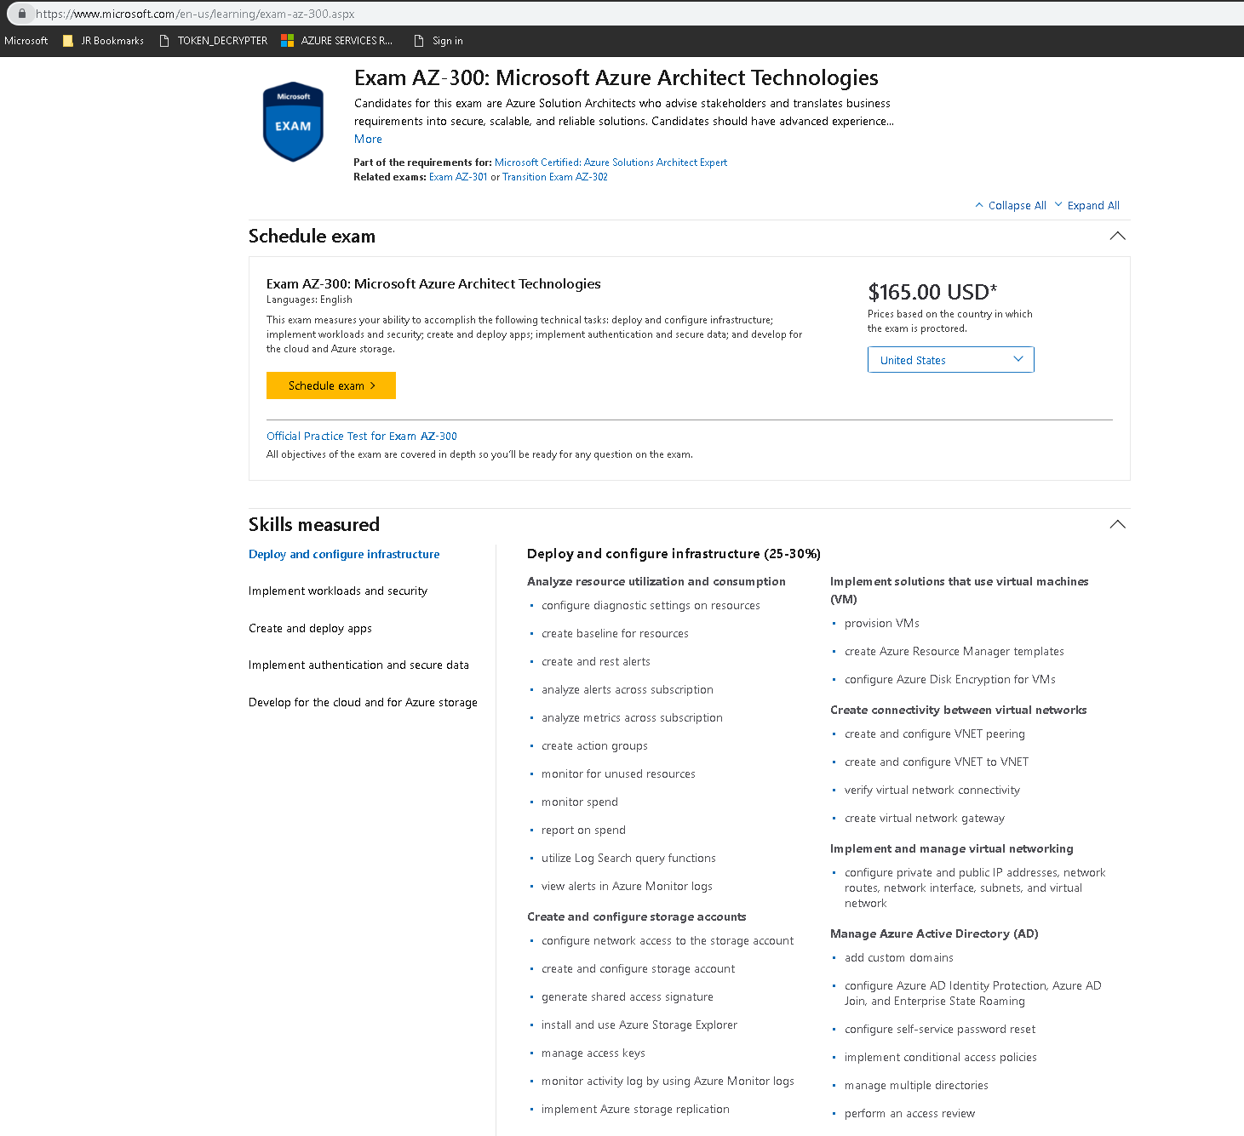
How this Training is organized
Exam
(AZ300 or AZ301)
Area
(Deploy and configure infra)
Module/Objective
(Analyze resource utilization and consumption)

Slide 3
Week 1 Deploy and Configure Infrastructure (25-30%)

Slide 4
Series Agenda
1
Kickoff
5
Implement Authentication and Secure Data (5-10%)
2
Deploy and Configure Infrastructure
(25-30%)
6
Develop for the Cloud
(20-25%)
3
Implement Workloads and Security (20-25%)
4
Create and Deploy Apps (5-10%)

Slide 5
Series Agenda
1
Kickoff
5
Implement Authentication and Secure Data (5-10%)
2
Deploy and Configure Infrastructure
(25-30%)
6
Develop for the Cloud
(20-25%)
3
Implement Workloads and Security (20-25%)
4
Create and Deploy Apps (5-10%)

Slide 6

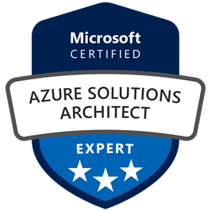
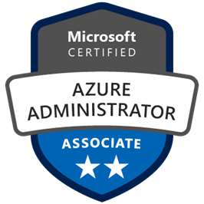
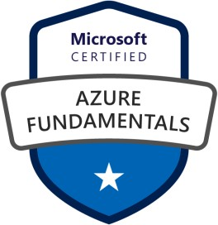



Jordan Radkov
Cloud Solution Architect based in the Munich
10+years in the industry in infrastructure administration , automation and now cloud
Constant learner - Ancora Imparo

Slide 7
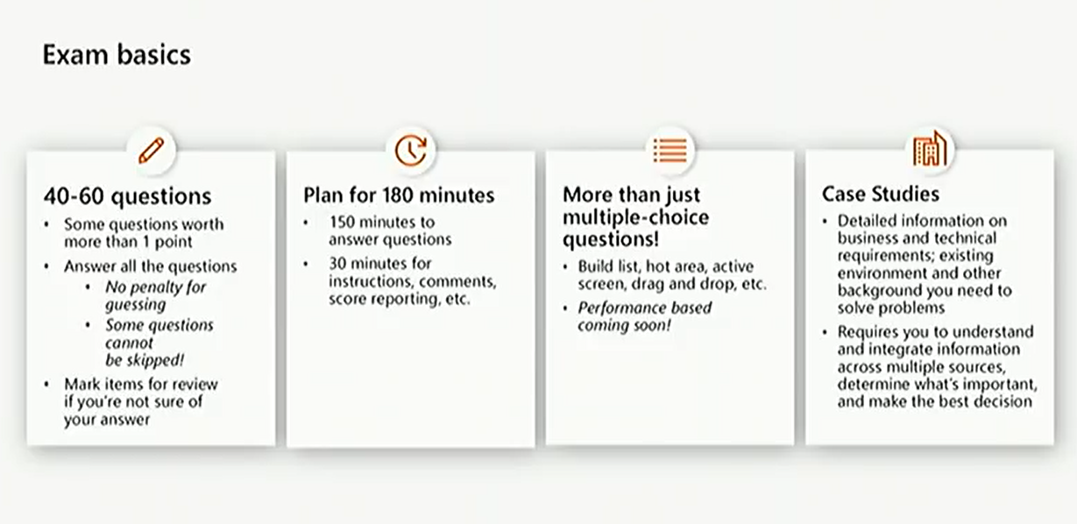
Ignite - https://www.youtube.com/watch?v=u1myyD_cGVQ

Slide 8
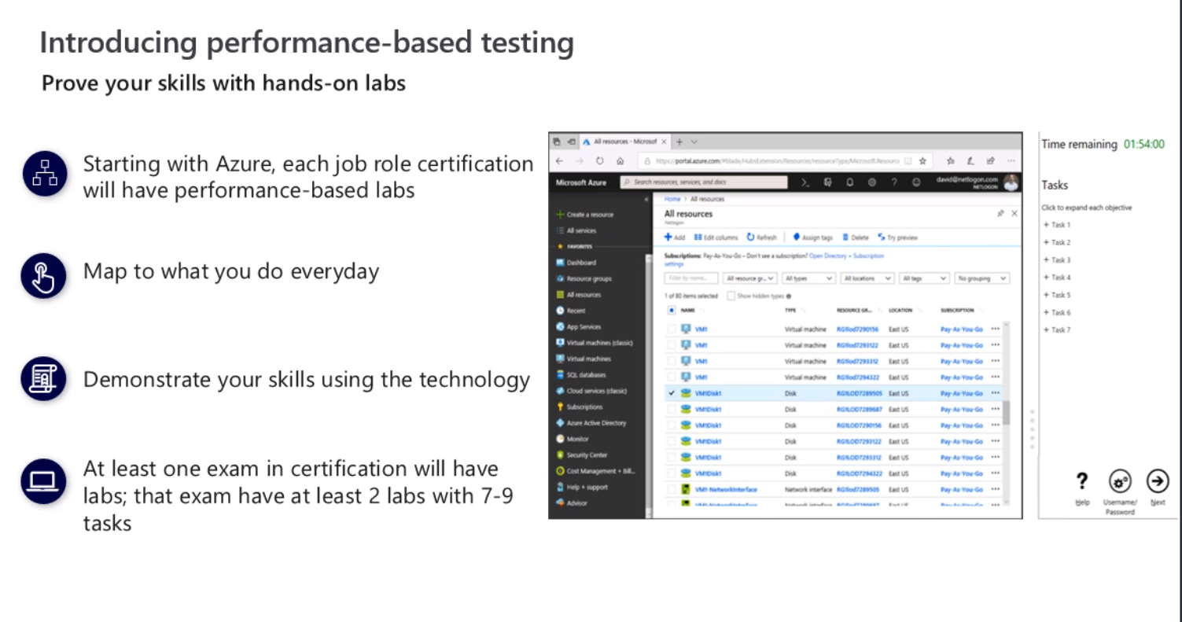
Notes:
Expect Labs and hands-on tasks

Slide 9
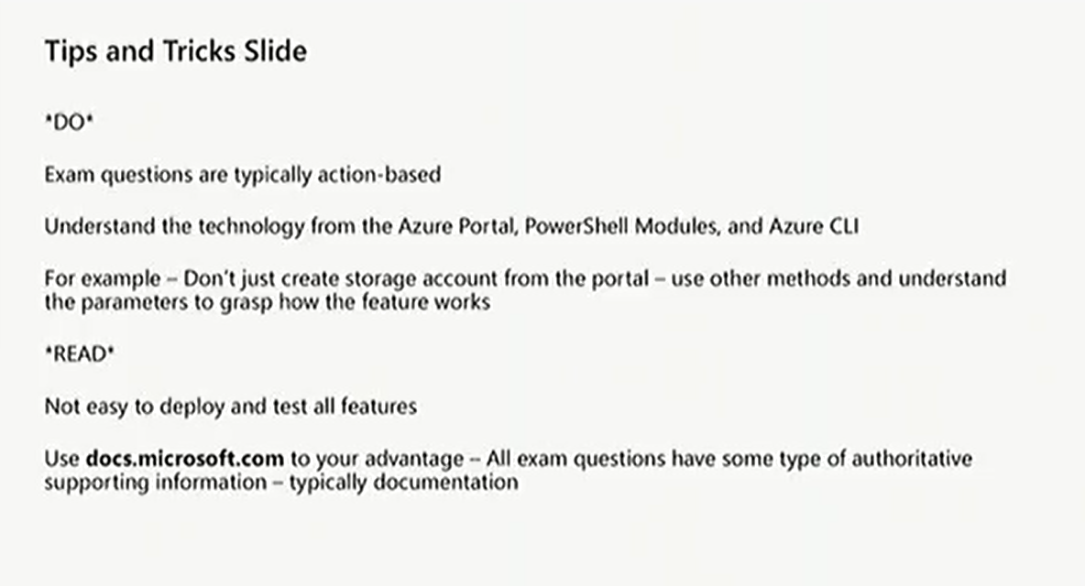
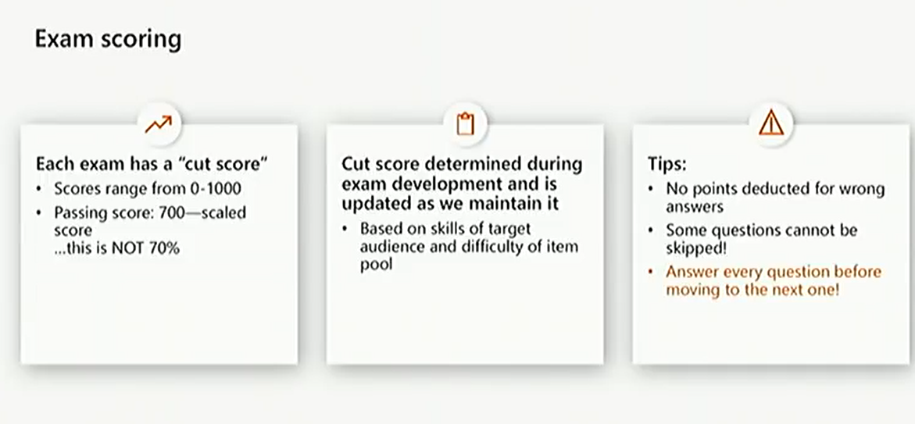

Slide 10
Objective Review - Deploy and Configure Infrastructure (25-30%)
Analyze resource utilization and consumption
May include but not limited to: Configure diagnostic settings on resources; create baseline for resources; create and rest alerts; analyze alerts across subscription; analyze metrics across subscription; create action groups; monitor for unused resources; monitor spend; report on spend; utilize Log Search query functions; view alerts in Log Analytics.
Create and configure storage accounts
May include but not limited to: Configure network access to the storage account; create and configure storage account; generate shared access signature; install and use Azure Storage Explorer; manage access keys; monitor activity log by using Log Analytics; implement Azure storage replication
Create and configure a Virtual Machine (VM) for Windows and Linux
May include but not limited to: Configure high availability; configure monitoring, networking, storage, and virtual machine size; deploy and configure scale sets

Slide 11
Objective Review - Deploy and Configure Infrastructure (25-30%) – cont’d
Automate deployment of Virtual Machines (VMs)
May include but not limited to: Modify Azure Resource Manager (ARM) template; configure location of new VMs; configure VHD template; deploy from template; save a deployment as an ARM template; deploy Windows and Linux VMs
Create connectivity between virtual networks
May include but not limited to: Create and configure VNET peering; create and configure VNET to VNET; verify virtual network connectivity; create virtual network gateway
Implement and manage virtual networking
May include but not limited to: Configure private and public IP addresses, network routes, network interface, subnets, and virtual network
Manage Azure Active Directory (AD)
May include but not limited to: Add custom domains; configure Azure AD Identity Protection, Azure AD Join, and Enterprise State Roaming; configure self-service password reset; implement conditional access policies; manage multiple directories; perform an access review
Implement and manage hybrid identities
May include but not limited to: Install and configure Azure AD Connect; configure federation and single sign-on; manage Azure AD Connect; manage password sync and writeback

Slide 12
What we have covered so far…
How do I communicate with Azure – portal.azure.com, Powershell, Azure CLI, API,
ARM Azure Resource Manager
Subscriptions, accounts, directories (tenants)
RBAC

Slide 13
Objective Review - #1
Analyze resource utilization and consumption
Configure diagnostic settings on resource
Create baseline for resources
Create and rest alert
Analyze alerts across subscription
Analyze metrics across subscription
Create action groups
Monitor for unused resources
Monitor spend
Report on spend
Utilize Log Search query functions
View alerts in Log Analytics

Slide 14
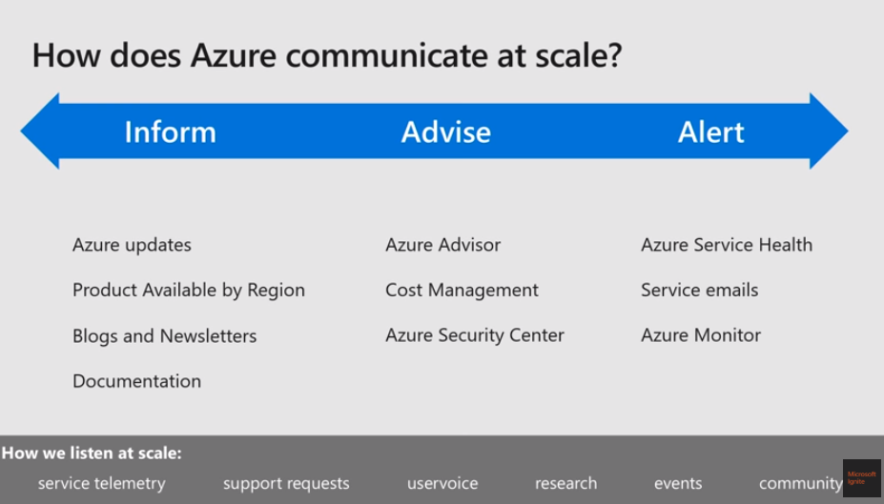
Azure Advisor
Notes:
How does Azure communicate with you at scale
How do we inform you ( via updates, docu , products available by region )
How do we advise you ( Azure Advisors )
How do we alert you ( if there is a service issue )

Slide 15
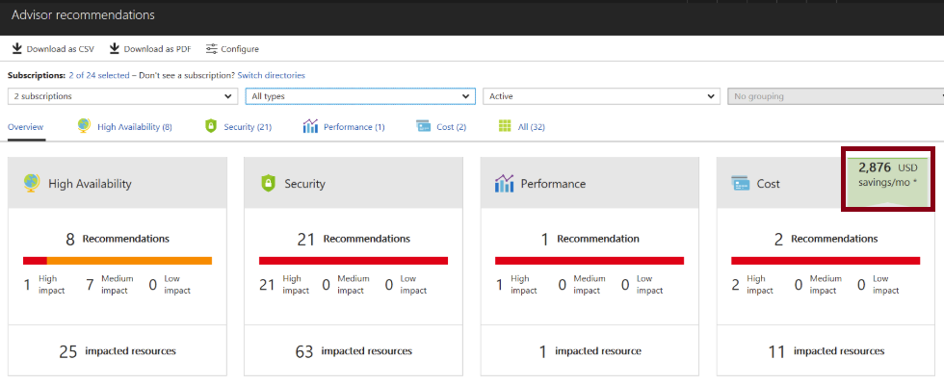
Azure Advisor
Personalized cloud consultant
Analyzes your configuration and recommends solutions
Four areas: High Availability, Security, Performance, and Cost
Notes:
FREE
Advisor is a personalized cloud consultant that helps you follow best practices to optimize your Azure deployments. It analyzes your resource configuration and usage telemetry and then recommends solutions that can help you improve the cost effectiveness, performance, high availability, and security of your Azure resources.
Advisor provides recommendations for virtual machines (including recommend prem disks) availability sets, application gateways, App Services, SQL servers, and Azure Cache for Redis.
Get proactive, actionable, and personalized best practices recommendations.
Improve the performance, security, and high availability of your resources, as you identify opportunities to reduce your overall Azure spend.
Get recommendations with proposed actions inline.
Advisor provides recommendations for virtual machines, availability sets, application gateways, App Services, SQL servers, and Redis Cache.
Introduction to Azure Advisor - https://docs.microsoft.com/en-us/azure/advisor/advisor-overview
Advisor Cost recommendations - https://docs.microsoft.com/en-us/azure/advisor/advisor-cost-recommendations

Slide 16
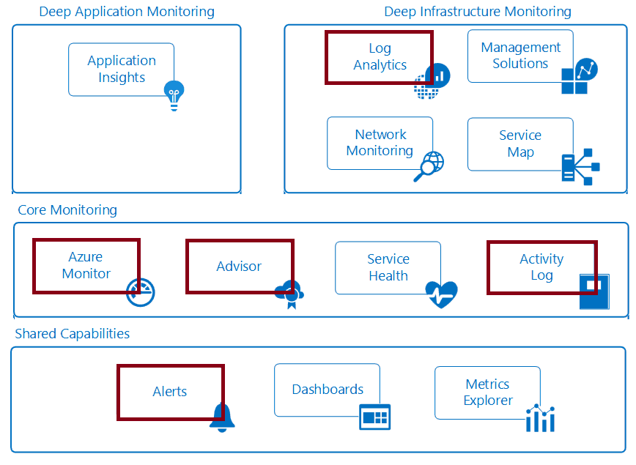
Introducing Azure Monitoring Services
Notes:
Monitoring is the act of collecting and analyzing data to determine the performance, health, and availability of your business application and the resources that it depends on.
An effective monitoring strategy helps you understand the detailed operation of the components of your application.
It also helps you increase your uptime by proactively notifying you of critical issues so that you can resolve them before they become problems.
Azure includes multiple services that individually perform a specific role or task in the monitoring space.
Together, these services deliver a comprehensive solution for collecting, analyzing, and acting on telemetry from your application and the Azure resources that support them.

Slide 17
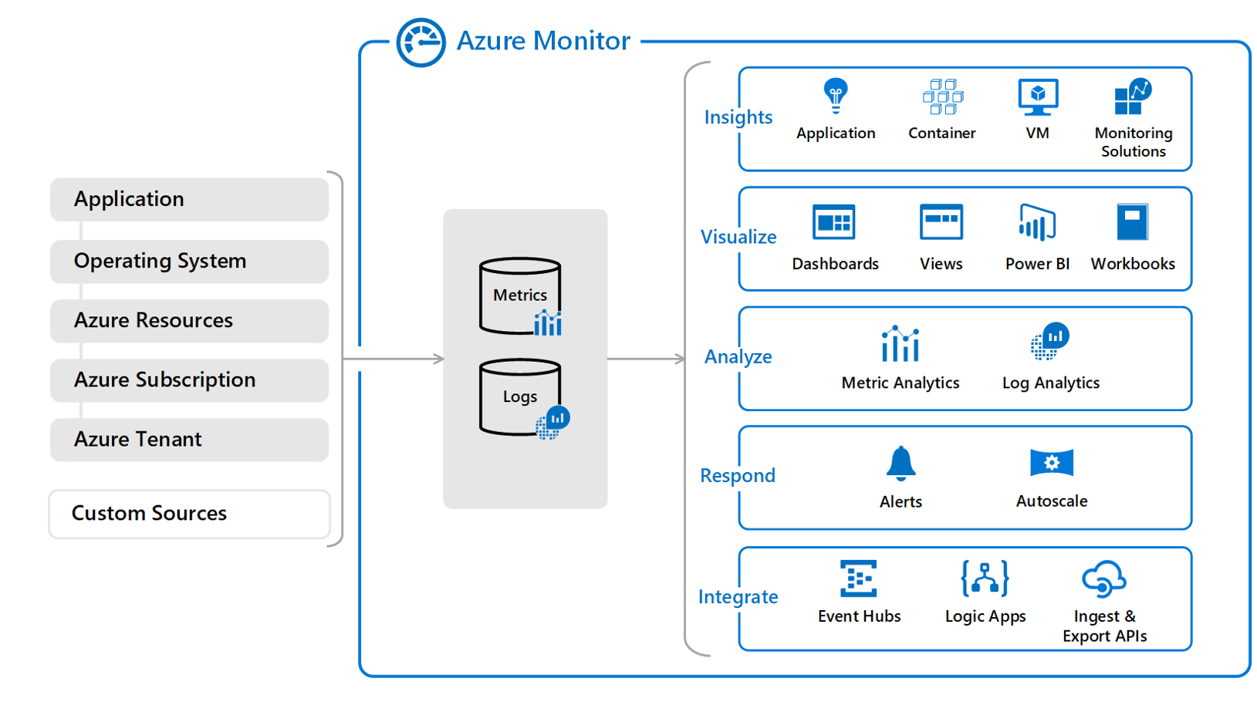
Notes:
At the center of the diagram are the data stores for metrics and logs which are the two fundamental types of data use by Azure Monitor. On the left are the sources that collect telemetry from different monitored resources and populate the data stores. On the right are the different functions that Azure Monitor performs with this collected data such as analysis, alerting, and streaming to external systems.

Slide 18
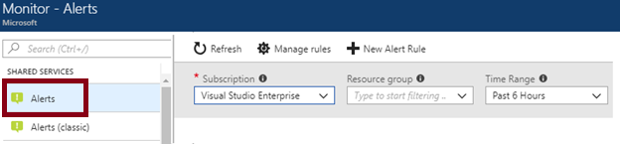
Azure Monitor Alerts
A unified authoring experience
Better creation workflow and fired alert notification
Consolidation into one view
Notes:
Azure Monitor now includes improved alerting and notifications such as SMS, email, and webhook. While Azure Monitor provides platform-level telemetry
The new alerts experience in Azure Monitor - https://docs.microsoft.com/en-us/azure/monitoring-and-diagnostics/monitoring-overview-unified-alerts

Slide 19
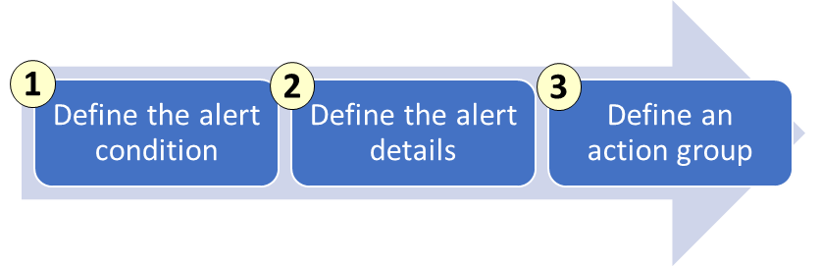
Creating Alert Rules
Define the alert condition with target, criteria, and logic
Define the alert details like rule name, description, and severity
Define the action group for notifications
Notes:
The new alerts experience in Azure Monitor - https://docs.microsoft.com/en-us/azure/monitoring-and-diagnostics/monitoring-overview-unified-alerts

Slide 20
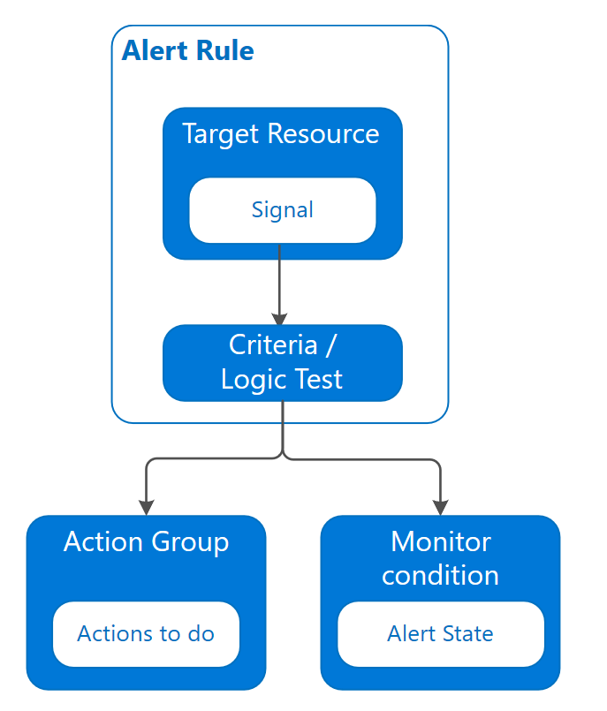
Notes:
Alert rule - The alert rule captures the target and criteria for alerting. The alert rule can be in an enabled or a disabled state. Alerts only fire when enabled.
The key attributes of an alert rule are:
Target Resource - Defines the scope and signals available for alerting. A target can be any Azure resource. Example targets: a virtual machine, a storage account, a virtual machine scale set, a Log Analytics workspace, or an Application Insights resource. For certain resources (like Virtual Machines), you can specify multiple resources as the target of the alert rule.
Signal - Signals are emitted by the target resource and can be of several types. Metric, Activity log, Application Insights, and Log.
Criteria - Criteria is combination of Signal and Logic applied on a Target resource. Examples:
Percentage CPU > 70%
Server Response Time > 4 ms
Result count of a log query > 100

Slide 21
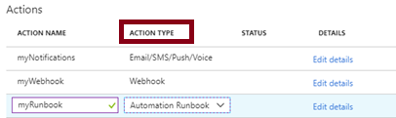
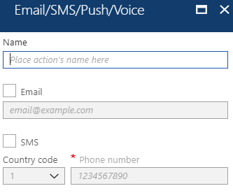
Action Groups
Configure a list of actions to take when the alert is triggered
Ensures the same actions are taken each time an alert is triggered
Action types: Email/SMS/Push/Voice, Logic App, Webhook, IT Service Management, or Automation Runbook
Notes:
An action group is a collection of notification preferences defined by the user. Azure Monitor and Service Health alerts are configured to use a specific action group when the alert is triggered.
Create an action group by using the Azure portal - https://docs.microsoft.com/en-us/azure/monitoring-and-diagnostics/monitoring-action-groups#create-an-action-group-by-using-the-azure-portal
Action specific information - https://docs.microsoft.com/en-us/azure/monitoring-and-diagnostics/monitoring-action-groups#action-specific-information
Rate limiting for Voice, SMS, emails, Azure App push notifications and webhook posts - https://docs.microsoft.com/en-us/azure/monitoring-and-diagnostics/monitoring-alerts-rate-limiting

Slide 22
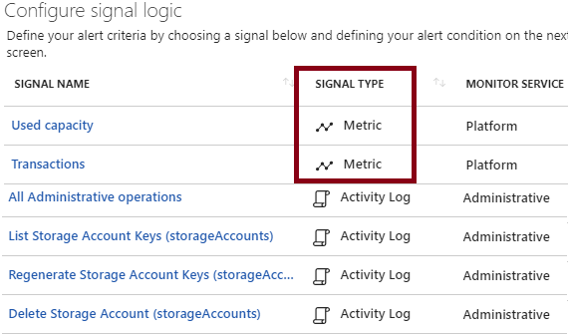
Signal Types and Metrics
Improved latency
Support for multi-dimensional metrics
More control over metric conditions
Combined monitoring of multiple metrics
Metrics from Logs
Notes:
Metric alerts in Azure Monitor provide a way to get notified when one of your metrics cross a threshold. Metric alerts work on a range of multi-dimensional platform metrics, custom metrics, Application Insights standard and custom metrics. In this article, we will describe how to create, view and manage metric alert rules through Azure portal and Azure CLI. You can also create metric alert rules using Azure Resource Manager templates
Metrics are lightweight and capable of supporting near real-time scenarios.
Logs contain different kinds of data organized into records with different sets of properties for each type. Telemetry such as events and traces are stored as logs in addition to performance data so that it can all be combined for analysis.
Alert rule terminology - https://docs.microsoft.com/en-us/azure/monitoring-and-diagnostics/monitoring-overview-unified-alerts#alert-rules-terminology

Slide 23
Practice: Alerts
Audit and receive notifications about important actions in your Azure subscription
Create a network security group
Browse the Activity Log in the portal
Browse an event in the Activity log
Create an Activity log alert
Test the Activity log alert
Notes:
Create, view, and manage alerts using Azure Monitor - https://docs.microsoft.com/en-us/azure/monitoring-and-diagnostics/monitor-alerts-unified-usage

Slide 24
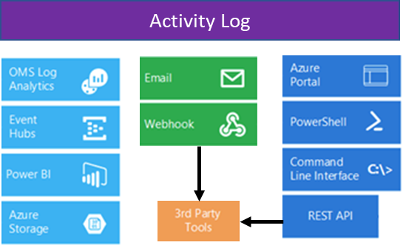
Overview of Activity Log - Video: Activity Log
Send data to Log Analytics for advanced search and alerts
Query or manage events in the Portal, PowerShell, CLI, and REST API
Stream information to Event Hub
Archive data to a storage account
Analyze data with Power BI
Notes:
The Azure Activity Log is a subscription log that provides insight into subscription-level events that have occurred in Azure.
The Activity Log differs from Diagnostic Logs (https://docs.microsoft.com/en-us/azure/monitoring-and-diagnostics/monitoring-overview-of-diagnostic-logs).
Activity Logs provide data about the operations on a resource from the outside (the "control plane").
Diagnostics Logs are emitted by a resource and provide information about the operation of that resource (the "data plane").
Monitor Subscription Activity with the Azure Activity Log - https://docs.microsoft.com/en-us/azure/monitoring-and-diagnostics/monitoring-overview-activity-logs

Slide 25
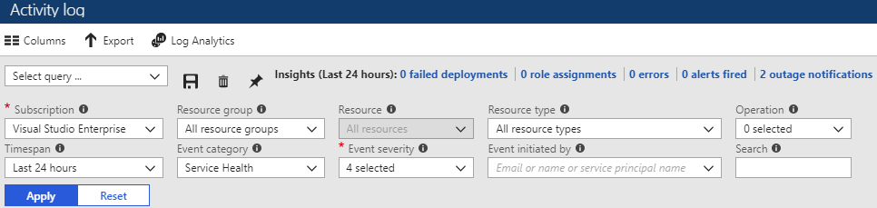
Query the Activity Log
Filter by: Subscription, Resource group, Resource (name), Resource type, Operation name, Timespan, Category, Severity, and Event initiated by
Notes:
Once you have defined a set of filters, you can save it as a query that is persisted across sessions if you ever need to perform the same query with those filters applied again in the future. You can also pin a query to your Azure dashboard to always keep an eye on specific events.
Query the Activity Log in the Azure portal - https://docs.microsoft.com/en-us/azure/monitoring-and-diagnostics/monitoring-overview-activity-logs#query-the-activity-log-in-the-azure-portal

Slide 26
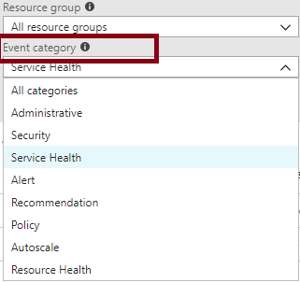
Event Categories
Administrative events
Service health events with status
Alert events
Autoscale events
Usage recommendations
Security events
Policy and Resource Health (reserved)
Notes:
Categories in the Activity Log - https://docs.microsoft.com/en-us/azure/monitoring-and-diagnostics/monitoring-overview-activity-logs#categories-in-the-activity-log

Slide 27
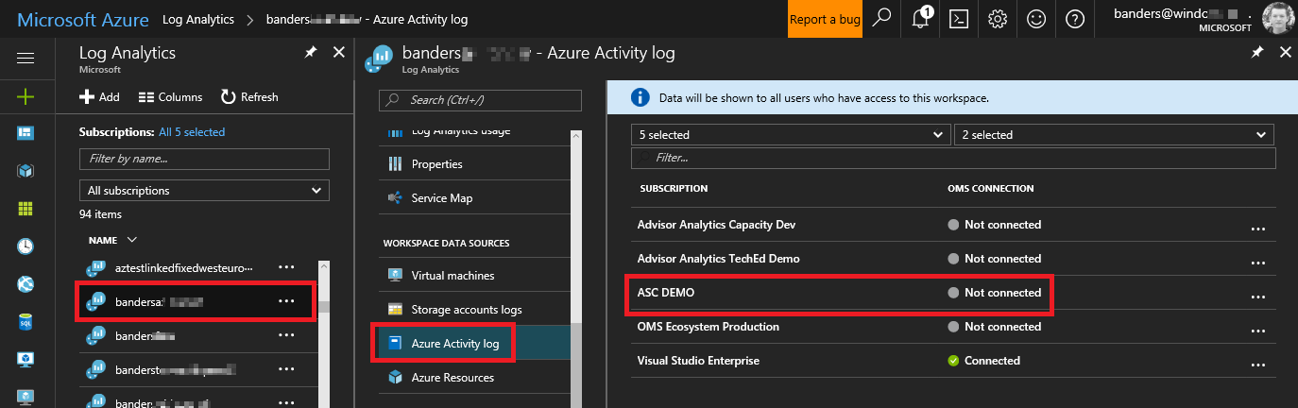
Activity Log and Log Analytics
Analyze the activity logs with pre-defined views
Analyze and search activity logs from multiple Azure subscriptions
See operational activities aggregated by status
View trends of activities happening on each of your Azure services
Notes:
Log Analytics collects activity logs and stores the logs for 90 days free of charge
Collect and analyze Azure activity logs in Log Analytics - https://docs.microsoft.com/en-us/azure/log-analytics/log-analytics-activity

Slide 28
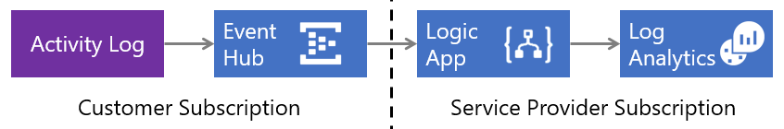
Collect Across Subscriptions
Low latency and minimal coding
Azure Activity Log sends events to an Event Hub where a Logic App sends them to your Log Analytics workspace
Notes:
The strategy used in this scenario is to have Azure Activity Log send events to an Event Hub where a Logic App sends them to your Log Analytics workspace.
Low latency since the Azure Activity Log is streamed into the Event Hub. The Logic App is then triggered and posts the data to Log Analytics.
Minimal code is required, and there is no server infrastructure to deploy.
Collect Azure Activity Logs into Log Analytics across subscriptions - https://docs.microsoft.com/en-us/azure/log-analytics/log-analytics-activity-logs-subscriptions

Slide 29
Practice: Activity Log
Configure activity logs in the Azure portal
Create an activity log alert
View the Activity Log in the Azure portal
Configure log profiles using the Azure portal
Enable streaming of the Activity Log
Archive the Activity Log using the portal
Configure the Activity Log Analytics solution for your workspaces
Notes:
The tasks listed are only a representative sampling of what you can do with Activity Logs. Explore some of the other tasks as you have time. Don’t forget to view the associated Activity Log dashboards. (Click the Azure Activity Logs tile to open the Azure Activity Logs dashboard.) Try some PowerShell and CLI tasks.
Create activity log alerts – https://docs.microsoft.com/en-us/azure/monitoring-and-diagnostics/monitoring-activity-log-alerts
Stream the Azure Activity Log to Event Hubs – https://docs.microsoft.com/en-us/azure/monitoring-and-diagnostics/monitoring-stream-activity-logs-event-hubs
Archive the Azure Activity Log – https://docs.microsoft.com/en-us/azure/monitoring-and-diagnostics/monitoring-archive-activity-log
Collect and analyze Azure activity logs in Log Analytics - https://docs.microsoft.com/en-us/azure/log-analytics/log-analytics-activity

Slide 30
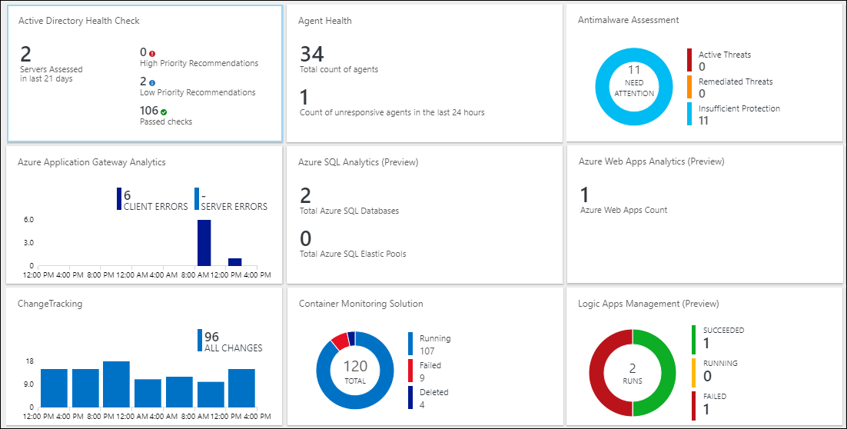
Video: Log Analytics
Notes:
Log Analytics helps you collect, correlate, search, and act on log and performance data generated by operating systems and applications. It gives you real-time operational insights using integrated search and custom dashboards to readily analyze millions of records across all your workloads and servers regardless of their physical location.
Log Analytics gives you a single interface for consuming and correlating the data, covering both Linux and Windows Server.

Slide 31
Log Analytics Scenarios
Example 1 - Assessing updates
IT Administrators assess systems update requirements
Must be able to accurately schedule updates
OMS/Log Analytics collects data from all customers performing updates
Uses "Crowd-sourced" data to provide an average time to help meet strict SLAs
Example 2 - Change tracking
Troubleshooting operational incidents is a complex process
OMS/Log Analytics let you perform analysis from multiple angles, using a variety of sources
Everything correlated through a single interface
Track issues such as unexpected system reboots or shutdowns
Notes:
‎
What is Log Analytics? https://docs.microsoft.com/en-us/azure/log-analytics/log-analytics-overview
What’s new in Microsoft Operations Management Suite: Log Analytics - https://blog.tyang.org/wp-content/uploads/2016/04/Whats-New-in-OMS.pdf
Log Analytics FAQ - https://azure.microsoft.com/en-us/services/log-analytics/faq/
Unified Alerts in Log Analytics - https://docs.microsoft.com/en-us/azure/log-analytics/log-analytics-alerts

Slide 32
Practice: Collect and Analyze Data
Part 1
Collect data about virtual machines
Create a workspace
Enable Log Analytics on virtual machines
Collect event and performance data
View the data collected
Part 2
View or analyze data collected with Log Analytics search
Search, modify, and filter event data
Work with performance data
Notes:
Writing a query - https://docs.microsoft.com/en-us/azure/log-analytics/log-analytics-log-search#writing-a-query

Slide 33
Practice: Analysis with Log Analytics
Microsoft Online Labs has a self-paced Deep Analysis with Microsoft Azure Log Analytics exercise.
Focus on the basics of Azure Insight and Analytics
Explore Log Analytics, log searches, analysis of Service Map and Network Performance Monitor solutions
Notes:
Microsoft Online Labs - https://www.microsoft.com/handsonlabs/SelfPacedLabs

Slide 34
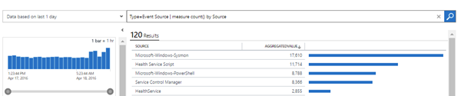
Log Analytics Querying
Log Analytics provides a query syntax
Quickly retrieve and consolidate data in the repository
Save or have log searches run automatically to create an alert
Export the data to Power BI or Excel
Notes:
Azure Log Analytics – meet our new query language - https://azure.microsoft.com/en-us/blog/azure-log-analytics-meet-our-new-query-language-2/

Slide 35
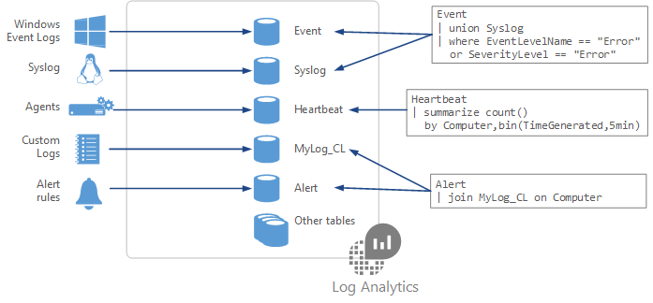
Query Language Syntax
Event
| where (EventLevelName == "Error")
| where (TimeGenerated > ago(1days))
| summarize ErrorCount = count() by Computer
| top 10 by ErrorCount desc
Notes:
Understanding log searches in Log Analytics - https://docs.microsoft.com/en-us/azure/log-analytics/log-analytics-log-search

Slide 36
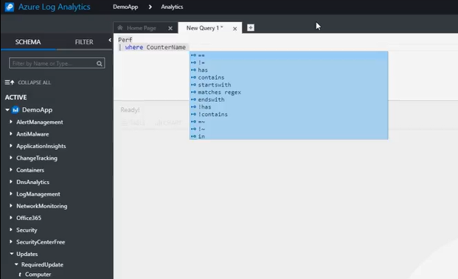
Demonstration: Log Analytics Querying
Intellisense for query completion

Slide 37
Practice: Log Analytics Query
Access the live Log Analytics Querying Demonstration workspace where you can run and test queries
Some of the testing queries are
See the volume of data collected in the last 24 hours in intervals of 30 minutes
Chart the distribution of billable data by type, over the last 24 hours
Find out which computers were alive in the past 2 days but haven't sent any data in the last 6 hours
Notes:
Getting Started with the Analytics Portal - https://portal.loganalytics.io/demo#/discover/home

Slide 38
Network Watcher
Azure Network Watcher provides tools to monitor, diagnose, view metrics, and enable or disable logs for resources in an Azure virtual network.
Monitor communication between a virtual machine and an endpoint
Connection monitor provides the minimum, average, and maximum latency observed over time
Network performance monitor
Notes:
Network performance monitor is a cloud-based hybrid network monitoring solution that helps you monitor network performance between various points in your network infrastructure. It also helps you monitor network connectivity to service and application endpoints and monitor the performance of Azure ExpressRoute. Network performance monitor detects network issues like traffic blackholing, routing errors, and issues that conventional network monitoring methods aren't able to detect. The solution generates alerts and notifies you when a threshold is breached for a network link. It also ensures timely detection of network performance issues and localizes the source of the problem to a particular network segment or device

Slide 39
Quiz
1. Activity Logs can not be ingested by Log Analytics to record all Azure platform operations performed by users. True or False ?
2. There are three types of metrics for Azure Monitor - Metrics, Logs and Application Counters. Yes or No ?
3. Name at least three of the multiple types of sources for Azure monitor.
Notes:
Custom, tenant, subscription, resource, os, app

Slide 40
Quiz
Log Analytics can ingest data from the following sources:
A) virtual machines
B) on-prem SCOM instance
C) Azure firewall
D) All of the above

Slide 41
Objective Review - #2
Create and configure storage accounts
Configure network access to the storage account
Create and configure storage account
Generate shared access signature
Install and use Azure Storage Explorer
Manage access keys
Monitor activity log by using Log Analytics
Implement Azure storage replication

Slide 42
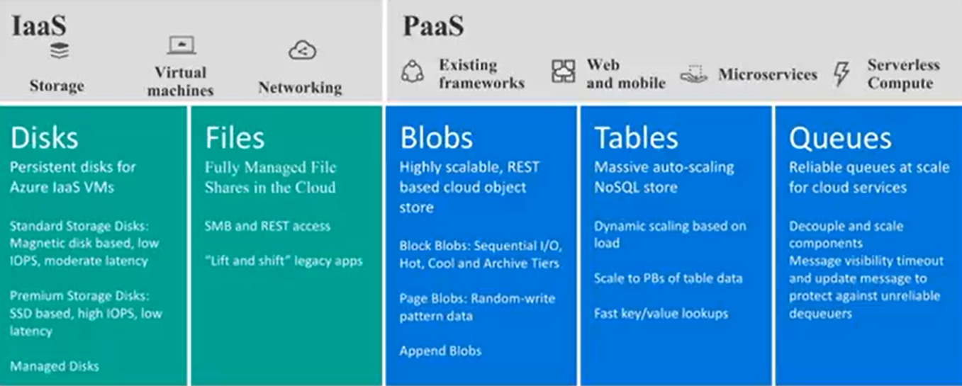
Introduction to Azure Storage
Notes:
Introduction to Azure Storage - https://www.youtube.com/watch?v=fUvQR45QaYM

Slide 43
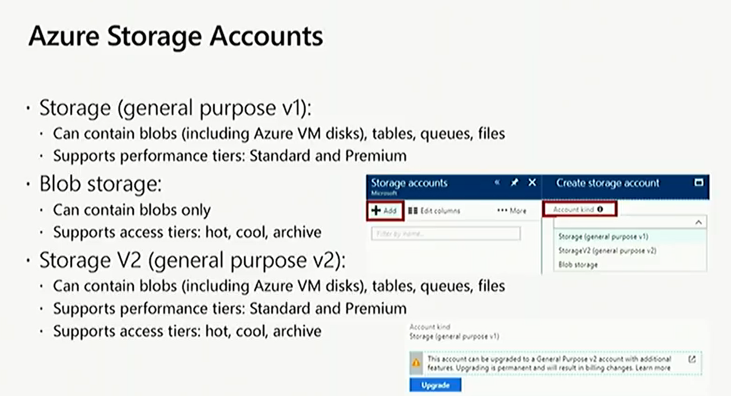

Slide 44
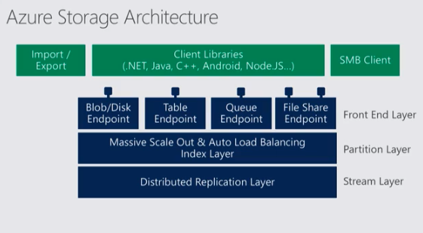

Slide 45
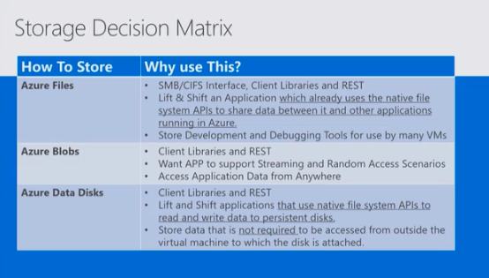

Slide 46
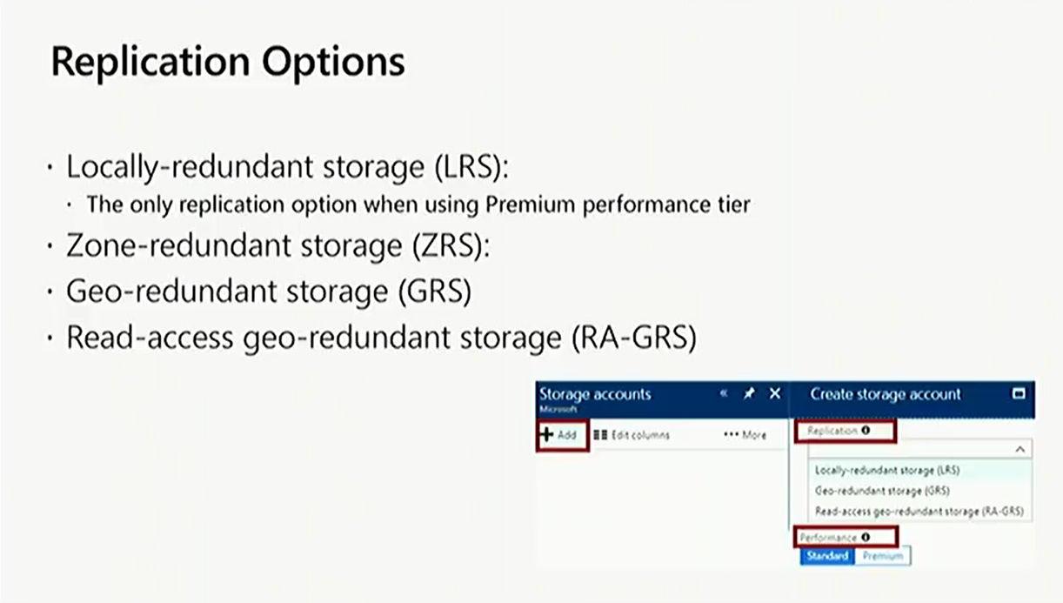

Slide 47
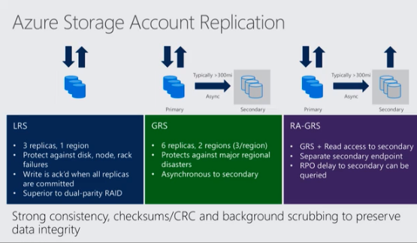
Notes:
https://docs.microsoft.com/en-us/azure/storage/common/storage-redundancy

Slide 48
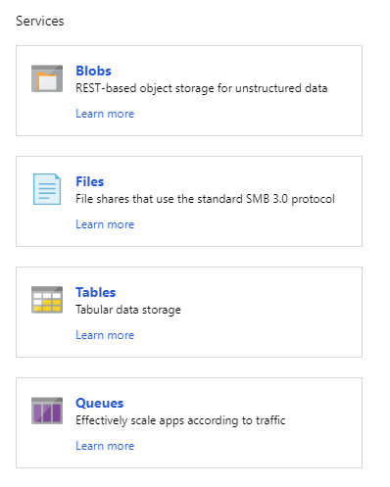
Azure Storage
A service that you can use to store files, messages, tables, and other types of information
Three categories of Azure storage:
Storage for virtual machines – Disks and File Shares
Unstructured data – Blobs and Data Lake Store
Structured data - Tables, Cosmos DB, and Azure SQL DB
Notes:
Azure Storage - https://azure.microsoft.com/en-us/services/storage/

Slide 49
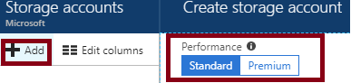
Azure Storage Accounts - Standard and Premium Storage Accounts
Standard:
Backed by magnetic drives (HDD)
Lowest cost per GB
Premium:
Backed by solid state drives (SSD)
Can only be used with Azure VM disks
99.99% SLA
Notes:
It is not possible to convert a Standard storage account to Premium storage account or vice versa. You must create a new storage account with the desired type and copy data, if applicable, to a new storage account.

Slide 50
Storage Account Endpoints
Every object has a unique URL address
The storage account name forms the subdomain of that address
The subdomain and domain name forms an endpoint
Blob service: http://mystorageaccount.blob.core.windows.net
Table service: http://mystorageaccount.table.core.windows.net
Queue service: http://mystorageaccount.queue.core.windows.net
File service: http://mystorageaccount.file.core.windows.net
Notes:
A Blob storage account only exposes the Blob service endpoint. And, you can also configure a custom domain name to use with your storage account.
Storage Account Endpoints - https://docs.microsoft.com/en-us/azure/storage/common/storage-create-storage-account?toc=%2fazure%2fstorage%2fblobs%2ftoc.json#storage-account-endpoints
Note that you can configure custom domains here

Slide 51
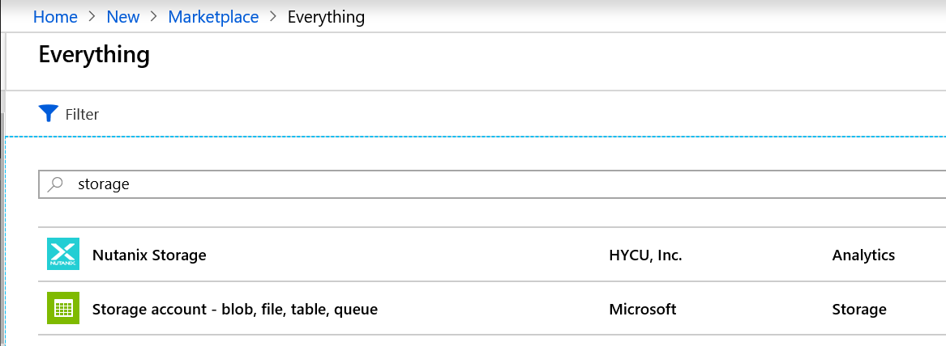
Demonstration: Creating Storage Accounts
Create a storage account using Azure Marketplace (Portal)
PowerShell
# Create new storage account New-AzureRMStorageAccount -ResourceName storage -Name storage2test -SkuName Standard LRS -Location 'west us’
ARM template
Notes:
Creating Storage Accounts - https://www.youtube.com/watch?v=7v2ZXPX9ETs
Demo - Chromium

Slide 52
Practice: Storage Accounts
Microsoft Online Labs has a self-paced Assessing on-premises VMware environments with Azure Migrate lab
Understand and deploy storage accounts
Explore key storage concepts and resources
Notes:
Microsoft Online Labs - https://www.microsoft.com/handsonlabs/SelfPacedLabs
If you encounter problems with the sign in process, or the provisioning process is taking longer, you may want to try using different web browsers. Also, you can open a support ticket using the Help link.

Slide 53
Practice: Storage Account Management
How to create a GPv2 storage account
How to convert a GPv1 or Blob storage account to a GPv2 storage account
How to set the account in a GPv2 storage account
How to set a blob tier in a Blob storage or GPv2 storage account
Notes:
FAQ - https://docs.microsoft.com/en-us/azure/storage/common/storage-account-options#faq

Slide 54
Storage Explorer & Manage Access Key
Storage Explorer - Reminder to install and use it
Manage Access Key
Storage Account roles:
Owner
Contributor
Reader
Storage Account Contributor
User Access Administrator
VM Contributor
Least privilege
Notes:
Storage Account - Roles for storage include (but are not limited to) the following roles:
Owner – They can manage everything, including access.
Contributor – They can do anything the owner can do except assign access. Someone with this role can view and regenerate the storage account keys. With the storage account keys, they can access the data objects.
Reader – They can view information about the storage account, except secrets. For example, if you assign a role with reader permissions on the storage account to someone, they can view the properties of the storage account, but they can't make any changes to the properties or view the storage account keys.
Storage Account Contributor – They can manage the storage account – they can read the subscription's resource groups and resources, and create and manage subscription resource group deployments. They can also access the storage account keys, which in turn means they can access the data plane.
User Access Administrator – They can manage user access to the storage account. For example, they can grant Reader access to a specific user.
Virtual Machine Contributor – They can manage virtual machines but not the storage account to which they are connected. This role can list the storage account keys, which means that the user to whom you assign this role can update the data plane.

Slide 55
Video: Storage Security Overview
Storage service encryption
Encryption in transit
Storage firewall - limit IP addresses through network security groups
Limit user access to storage accounts using RBAC
Analyze metrics and logs with Azure Monitor and Log Analytics
Storage keys
More granular security with Shared Access Signatures
Policy based signatures
Notes:
All data written to Azure Storage is automatically encrypted using Storage Service Encryption (SSE). For more information, see Announcing Default Encryption for Azure Blobs, Files, Table and Queue Storage.
Azure Active Directory (Azure AD) and Role-Based Access Control (RBAC) are supported for Azure Storage for both resource management operations and data operations, as follows:
You can assign RBAC roles scoped to the storage account to security principals and use Azure AD to authorize resource management operations such as key management.
Azure AD integration is supported in preview for data operations on the Blob and Queue services. You can assign RBAC roles scoped to a subscription, resource group, storage account, or an individual container or queue to a security principal or a managed identity for Azure resources. For more information, see Authenticate access to Azure Storage using Azure Active Directory (Preview).
Data can be secured in transit between an application and Azure by using Client-Side Encryption, HTTPS, or SMB 3.0.
OS and data disks used by Azure virtual machines can be encrypted using Azure Disk Encryption.
Delegated access to the data objects in Azure Storage can be granted using Shared Access Signatures.
Storage Security - https://www.youtube.com/watch?v=tcMyGYp_dQM

Slide 56
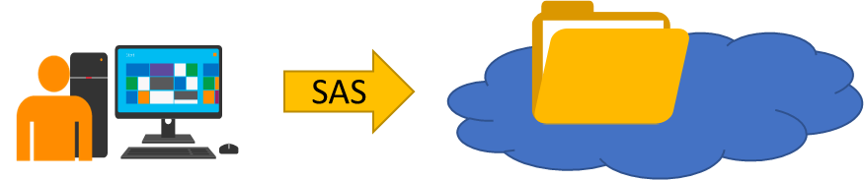
Shared Access Signature (SAS)
Provides delegated access to resources
Grants access to clients without sharing your storage account keys
The account SAS delegates access to resources in one or more of the storage services: Blob, Queue, Table, or File service
The service SAS delegates access to a resource in just one of the storage services
Notes:
A shared access signature provides delegated access to resources in your storage account. With a SAS, you can grant clients access to resources in your storage account, without sharing your account keys. This is the key point of using shared access signatures in your applications--a SAS is a secure way to share your storage resources without compromising your account keys.
Storage account key is Similar to root password so use SAS
You can use a SAS when you want to provide access to resources in your storage account to any client not possessing your storage account's access keys.
What is a shared access signature? - https://docs.microsoft.com/en-us/azure/storage/common/storage-dotnet-shared-access-signature-part-1?toc=%2fazure%2fstorage%2fblobs%2ftoc.json#what-is-a-shared-access-signature
When should you use a shared access signature? - https://docs.microsoft.com/en-us/azure/storage/common/storage-dotnet-shared-access-signature-part-1?toc=%2fazure%2fstorage%2fblobs%2ftoc.json#when-should-you-use-a-shared-access-signature

Slide 57
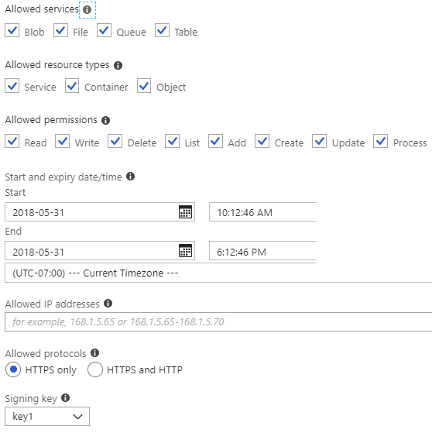
Configuring SAS Parameters
Account level SAS, full permissions
New-AzureStorageAccountSASToken
-Service Blob,File,Table,Queue
-ResourceType Service,Container,Object
-Permission "racwdlup"
Blob level SAS, full permissions
New-AzureStorageBlobSASToken
-Container "ContainerName"
-Blob "BlobName"
-Permission rwd
Notes:
Take a few minutes to access the Azure Portal. Select a Storage Account and click Shared Access Signature. Use the Information icon to step through each of the settings to learn more about what that parameter does.
New-AzureStorageAccountSASToken- https://docs.microsoft.com/en-us/powershell/module/azure.storage/new-azurestorageaccountsastoken?view=azurermps-6.8.1
New-AzureStorageBlobSASToken- https://docs.microsoft.com/en-us/powershell/module/azure.storage/new-azurestorageblobsastoken?view=azurermps-6.8.1

Slide 58
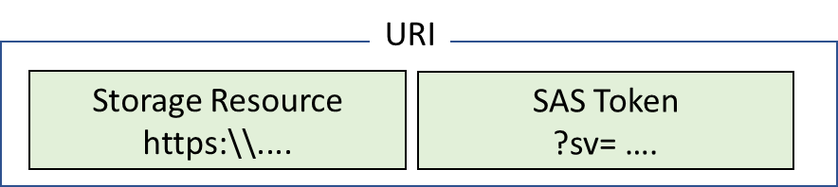
URI and SAS Parameters
A SAS is a signed URI that points to one or more storage resources
Consists of a storage resource URI and the SAS token
Includes parameters for resource URI, storage services version, services, resource types, start time, expiry time, resource, permissions, IP range, protocol, signature
Notes:
Storage SAS and Keys - https://www.youtube.com/watch?v=cLP2rh0wqhw
Shared access signature parameters - https://docs.microsoft.com/en-us/azure/storage/common/storage-dotnet-shared-access-signature-part-1?toc=%2fazure%2fstorage%2fblobs%2ftoc.json#shared-access-signature-parameters
Service SAS URI example - https://docs.microsoft.com/en-us/azure/storage/common/storage-dotnet-shared-access-signature-part-1#service-sas-uri-example
Account SAS URI example - https://docs.microsoft.com/en-us/azure/storage/common/storage-dotnet-shared-access-signature-part-1#account-sas-uri-example

Slide 59
Demonstration: Storage Encryption
Enable encryption either at REST or in transit
Secure transfer required option will require HTTPS for any connections that come into the storage account
Notes:
Storage Encryption - https://www.youtube.com/watch?v=zZHh2Hgb8r4
Azure storage uses RBAC (role based access control)
Always use HTTPS to create or distribute an SAS
Reference stored access policies where possible
Be careful with SAS start time
Be specific with the resource to be accessed
Best practices when using SAS - https://docs.microsoft.com/en-us/azure/storage/common/storage-dotnet-shared-access-signature-part-1#best-practices-when-using-sas
Configure Azure Storage Firewalls and Virtual Networks - https://docs.microsoft.com/en-us/azure/storage/common/storage-network-security

Slide 60
Practice: Shared Access Signatures
Generate an SAS in the Azure Portal
Use SAS to connect to your storage account through Storage Explorer
Configure additional SAS strings to work with different resources
Notes:
Don’t forget to review the videos in this lesson as you try some of these activities for yourself.
Using shared access signatures (SAS) – https://docs.microsoft.com/en-us/azure/storage/common/storage-dotnet-shared-access-signature-part-1

Slide 61
Quiz
Name three Azure storage services you can place in a storage account?
What are the replication options for a storage account ?
Accessing a storage service can be done in three ways. Via storage account keys, SAS or via a Managed Service Identity, which accesses the storage for me. True or False ?
Notes:
Azure Files, Azure Blob storage, Azure queue, table storage.
LRS, ZRS, GRS, RA-GRS

Slide 62
Objective Review - #3
Create and configure a Virtual Machine (VM) for Windows and Linux
Configure high availability
Configure monitoring, networking, storage, and virtual machine size
Deploy and configure scale sets

Slide 63
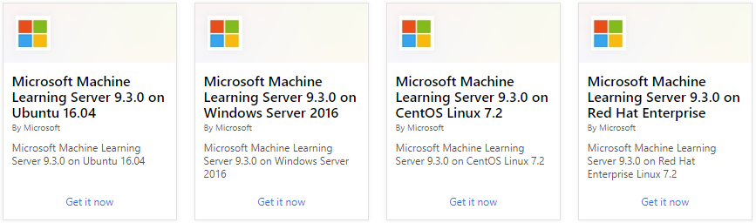
Supported Operating Systems
Windows Server includes many common products, requires a license, doesn’t support OS upgrades
Linux distributions are supported, upgrade of the OS is supported
Notes:
Microsoft server software support for Microsoft Azure virtual machines - https://support.microsoft.com/en-us/help/2721672/microsoft-server-software-support-for-microsoft-azure-virtual-machines
Linux on distributions endorsed by Azure - https://docs.microsoft.com/en-us/azure/virtual-machines/linux/endorsed-distros#supported-distributions–versions.

Slide 64
Demonstration: Deploying Linux Virtual Machines
Add an Ubuntu server from the Azure Marketplace
Configure settings in the Azure portal and create
Allow inbound rule SSH (TCP/22)
Connect to the running instance of the Linux VM through an SSH session
Notes:
Deploying Linux VMs - https://www.youtube.com/embed/k7mPJhRVXoA

Slide 65
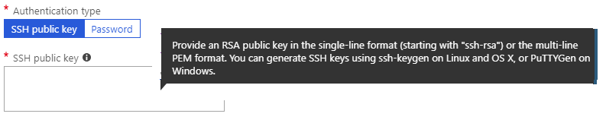
Connecting to Linux VMs
Authenticate with a SSH public key or password
SSH is an encrypted connection protocol that allows secure logins over unsecured connections
Notes:
Azure currently requires at least a 2048-bit key length and the SSH-RSA format for public and private keys.
How to use SSH keys with Windows on Azure - https://docs.microsoft.com/en-us/azure/virtual-machines/linux/ssh-from-windows#overview-of-ssh-and-keys

Slide 66
Video: Creating SSH Keys
Create SSH keys with ssh-keygen
If you can run a command shell such as Bash for Windows or GitBash (or Bash in Azure Cloud Shell), create an SSH key pair using the ssh-keygen command.
Create SSH keys with PuTTYgen
If you prefer to use a GUI-based tool to create SSH keys, you can use the PuTTYgen key generator. The steps to use PuTTYgen are shown in this video.
Notes:
Creating SSH Keys - https://www.youtube.com/embed/dVYU6I_Hpo4
Create SSH keys with PuTTYgen - https://docs.microsoft.com/en-us/azure/virtual-machines/linux/ssh-from-windows#create-ssh-keys-with-puttygen

Slide 67
Practice: Advanced Azure Virtual Machine and Compute
Configure a virtual machine scale set
Administer a download and install PowerShell on an Ubuntu server using Git Bash
Create and upload an automation script from an ARM template
Notes:
Microsoft Online Labs - https://www.microsoft.com/handsonlabs/SelfPacedLabs

Slide 68
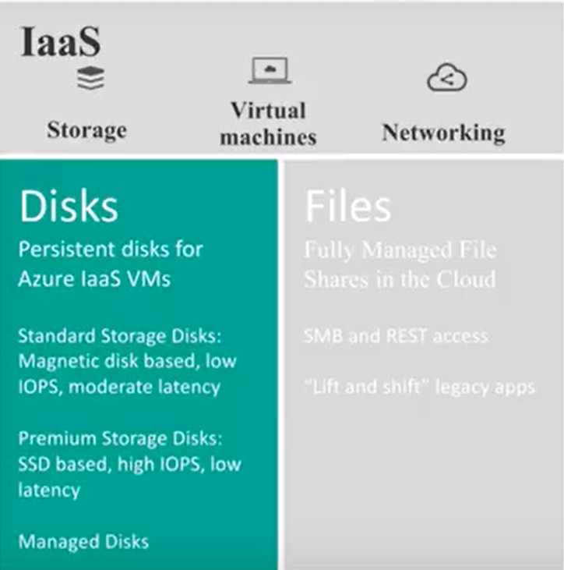
Video: Virtual Machine Storage
Disks are how virtual machines store their VHD files
Premium or Standard storage
Managed or unmanaged
Virtual Machine disk types
Operating System disks – SATA, C:
Temporary disk – short term storage
Data disks – depend on VM Type
Notes:
https://docs.microsoft.com/en-us/azure/site-recovery/migrate-tutorial-on-premises-azure
Note: This default numbers in this video are accurate as of the time of the recording. Azure is constantly being updated so be sure to check the documentation if something seems out of date.
Virtual Machine Storage - https://www.youtube.com/watch?v=og_rZYBLvCs

Slide 69
Move a VM from on premises to Azure with Site Recovery
Create Recovery Services Vault
Select replication goal
Set up source environment
Set up Target environment
Set up Replication policy
Enable Replication
Notes:
Know which VM’s can be move with ASR, things like max os Disk size (2 TB), Data disk size (4 TB), # of disks (64 or less), bitlock (no), 64 bit
https://docs.microsoft.com/en-us/azure/site-recovery/vmware-physical-azure-support-matrix

Slide 70
Demonstration: Virtual Machine Storage
Several ways to implement virtual machine storage
Storage configuration can be either managed or unmanaged
For VMs using unmanaged disks, you must manage the storage accounts
For VMs using managed disks, the storage account is set automatically
Notes:
VM Storage Demonstration - https://www.youtube.com/embed/sKg5Hz1tSmQ

Slide 71
Premium Storage
Delivers high-performance, low-latency SSD disk support
Use for virtual machines with input/output (I/O)-intensive workloads
Two types of disks: Unmanaged and Managed
Unmanaged disks require you to manage the storage accounts and VHDs
Managed disks are maintained by Azure (recommended)
Notes:
For the best performance for your application, we recommend that you migrate any VM disk that requires high IOPS to Premium Storage. If your disk does not require high IOPS, you can help limit costs by keeping it in standard Azure Storage. In standard storage, VM disk data is stored on hard disk drives (HDDs) instead of on SSDs.
Managed disks overview - https://docs.microsoft.com/en-us/azure/virtual-machines/windows/managed-disks-overview
Premium Storage - https://docs.microsoft.com/en-us/azure/virtual-machines/windows/premium-storage
Standard Storage - https://docs.microsoft.com/en-us/azure/virtual-machines/windows/standard-storage

Slide 72
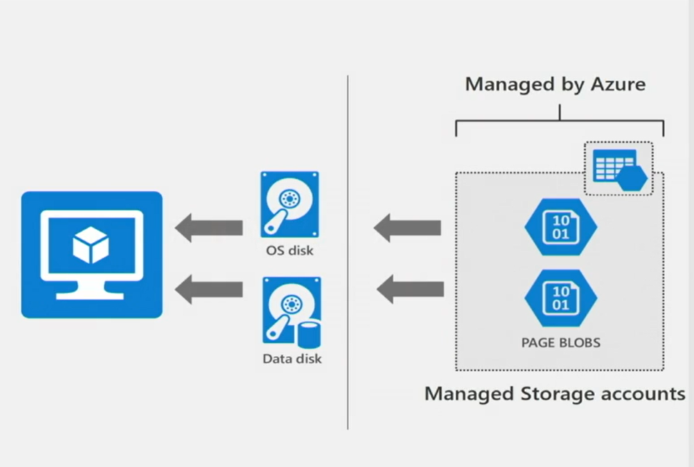
Video: Resiliency with Managed Disks
Managed disks – abstract storage accounts from customers
Granular access control – apply Azure RBAC
Better performance - storage account limits do not apply
Scale – thousands of disks per region per subscription
Notes:
Resiliency with Managed Disks - https://channel9.msdn.com/Blogs/Azure/Managed-Disks-for-Azure-Resiliency/player
Azure Managed Disks simplifies disk management for Azure IaaS VMs by managing the storage accounts associated with the VM disks. You only specify the type (Standard HDD, Standard SSD, or Premium SSD) and the size of disk you need, and Azure creates and manages the disk for you. This video covers managed disks, snapshots, and premium storage.

Slide 73
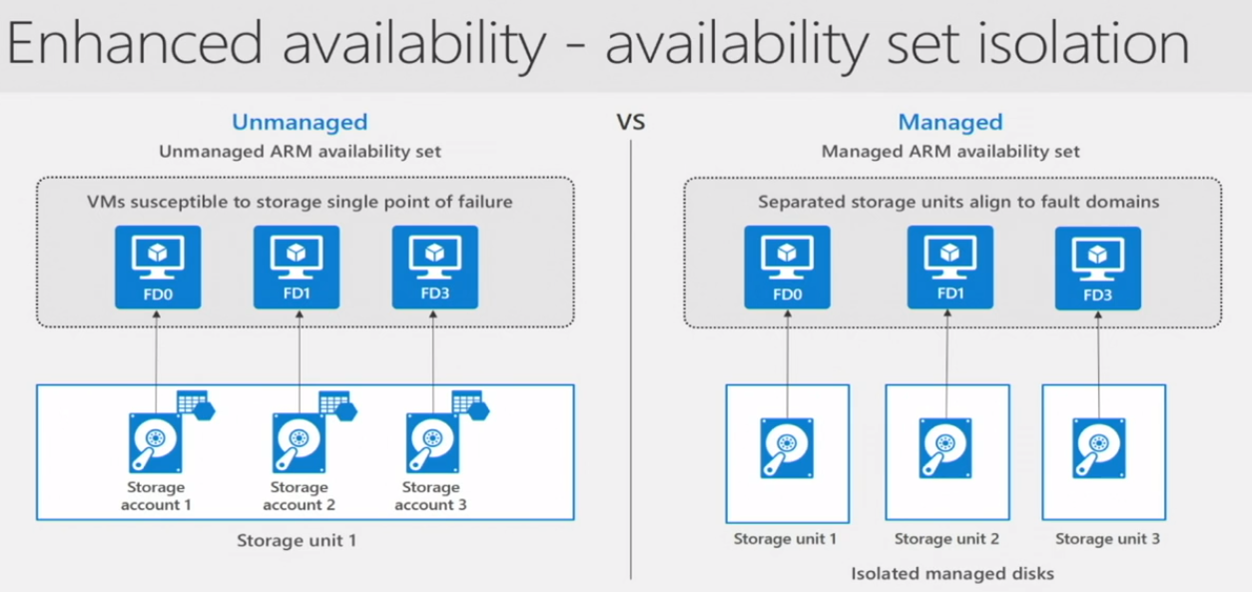
Resiliency with Managed Disks
Notes:
Resiliency with Managed Disks - https://channel9.msdn.com/Blogs/Azure/Managed-Disks-for-Azure-Resiliency/player
Azure Managed Disks simplifies disk management for Azure IaaS VMs by managing the storage accounts associated with the VM disks. You only specify the type (Standard HDD, Standard SSD, or Premium SSD) and the size of disk you need, and Azure creates and manages the disk for you. This video covers managed disks, snapshots, and premium storage.

Slide 74
Demonstration: Attach and Detach Disks
Attach additional data disks to existing VMS
Number of data disks determined by the class or type of VM you deploy
Understand your workload and how many disks you think you’ll need
Helps in sizing and choosing the correct size of VM when you deploy it
Notes:
Know the VM Types and what they are used for:
https://docs.microsoft.com/en-us/azure/virtual-machines/windows/sizes
Type Sizes Description
General purpose B, Dsv3, Dv3, DSv2, Dv2, Av2, DC Balanced CPU-to-memory ratio. Ideal for testing and development, small to medium databases, and low to medium traffic web servers.
Compute optimized Fsv2, Fs, F High CPU-to-memory ratio. Good for medium traffic web servers, network appliances, batch processes, and application servers. Memory optimized Esv3, Ev3, M, GS, G, DSv2, Dv2 High memory-to-CPU ratio. Great for relational database servers, medium to large caches, and in-memory analytics.
Storage optimized Lsv2, Ls High disk throughput and IO ideal for Big Data, SQL, NoSQL databases, data warehousing and large transactional databases.
GPU NV, NVv2, NC, NCv2, NCv3, ND, Ndv2 (Preview) Specialized virtual machines targeted for heavy graphic rendering and video editing, as well as model training and inferencing (ND) with deep learning. Available with single or multiple GPUs.
High performance compute H Our fastest and most powerful CPU virtual machines with optional high-throughput network interfaces (RDMA).
Attach and Detach Disks - https://www.youtube.com/embed/LXblaftKoxM

Slide 75
Demonstration: Upload Custom Disks
Upload and attach a local VHD file on the local system to a VM running in Azure
Create a storage account and a container to upload the VHD file
To upload the VHD, use PowerShell (Add-AzureRMVhd)
Create the new managed disk based on the uploaded VHD
Notes:
Upload Custom Disks - https://www.youtube.com/watch?v=uG1wVoc7oVQ

Slide 76
Demonstration: Migrating from Managed Disks
Convert an unmanaged disk to a managed disk
Need to power off the virtual machine during the operation
Consider downtime and availability of applications
Notes:
Migrating from Managed Disks - https://www.youtube.com/watch?v=hXCBMQlPfR8

Slide 77
Virtual Machine Storage
Attach a data disk to a Windows VM using PowerShell
Detach a data disk from a Windows virtual machine
Convert Azure managed disks storage from standard to premium, and vice versa
Convert a Windows virtual machine from unmanaged disks to managed disks.
Notes:
✔️Can you see the advantage of completing tasks with PowerShell?

Slide 78
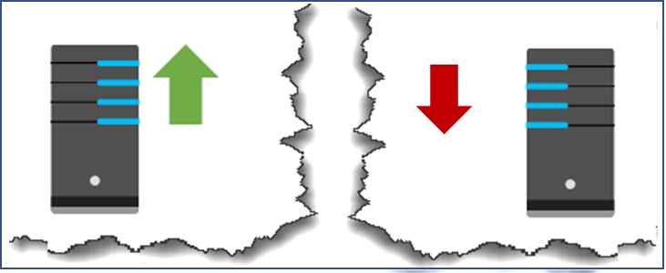
Availability Sets
Two or more instances in a set, 99.95% uptime
Configure multiple virtual machines in an Availability Set
Configure each application tier into separate Availability Sets
Combine a Load Balancer with Availability Sets
Use managed disks with the virtual machines
Notes:
You can create a virtual machine and an availability set at the same time. Or you create an availability set and then add virtual machines to it. This is a matter of personal preference.
SLA for Virtual Machines - https://azure.microsoft.com/en-us/support/legal/sla/virtual-machines/v1_8/

Slide 79
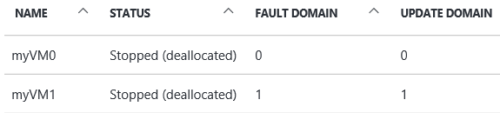
Update and Fault Domains
Update domains lets Azure to perform incremental or rolling upgrades across a deployment. During planned maintenance, only one update domain is rebooted at a time.
Fault Domains are a group of virtual machines that share a common set of hardware, switches, that share a single point of failure. VMs in an availability set are placed in at least two fault domains
Notes:
Availability sets are made up of update domains and fault domains:
Update domains. When a maintenance event occurs (such as a performance update or critical security patch applied), the update is sequenced through update domains.
Fault domains. Fault domains provide for the physical separation of a workload across different hardware in the datacenter
Placing your virtual machines into an availability set does not protect your application from operating system or application-specific failures, it does limit the impact of potential physical hardware failures, network outages, or power interruptions.
Configure multiple virtual machines in an availability set for redundancy - https://docs.microsoft.com/en-us/azure/virtual-machines/windows/manage-availability?toc=%2Fazure%2Fvirtual-machines%2Fwindows%2Ftoc.json#configure-multiple-virtual-machines-in-an-availability-set-for-redundancy

Slide 80
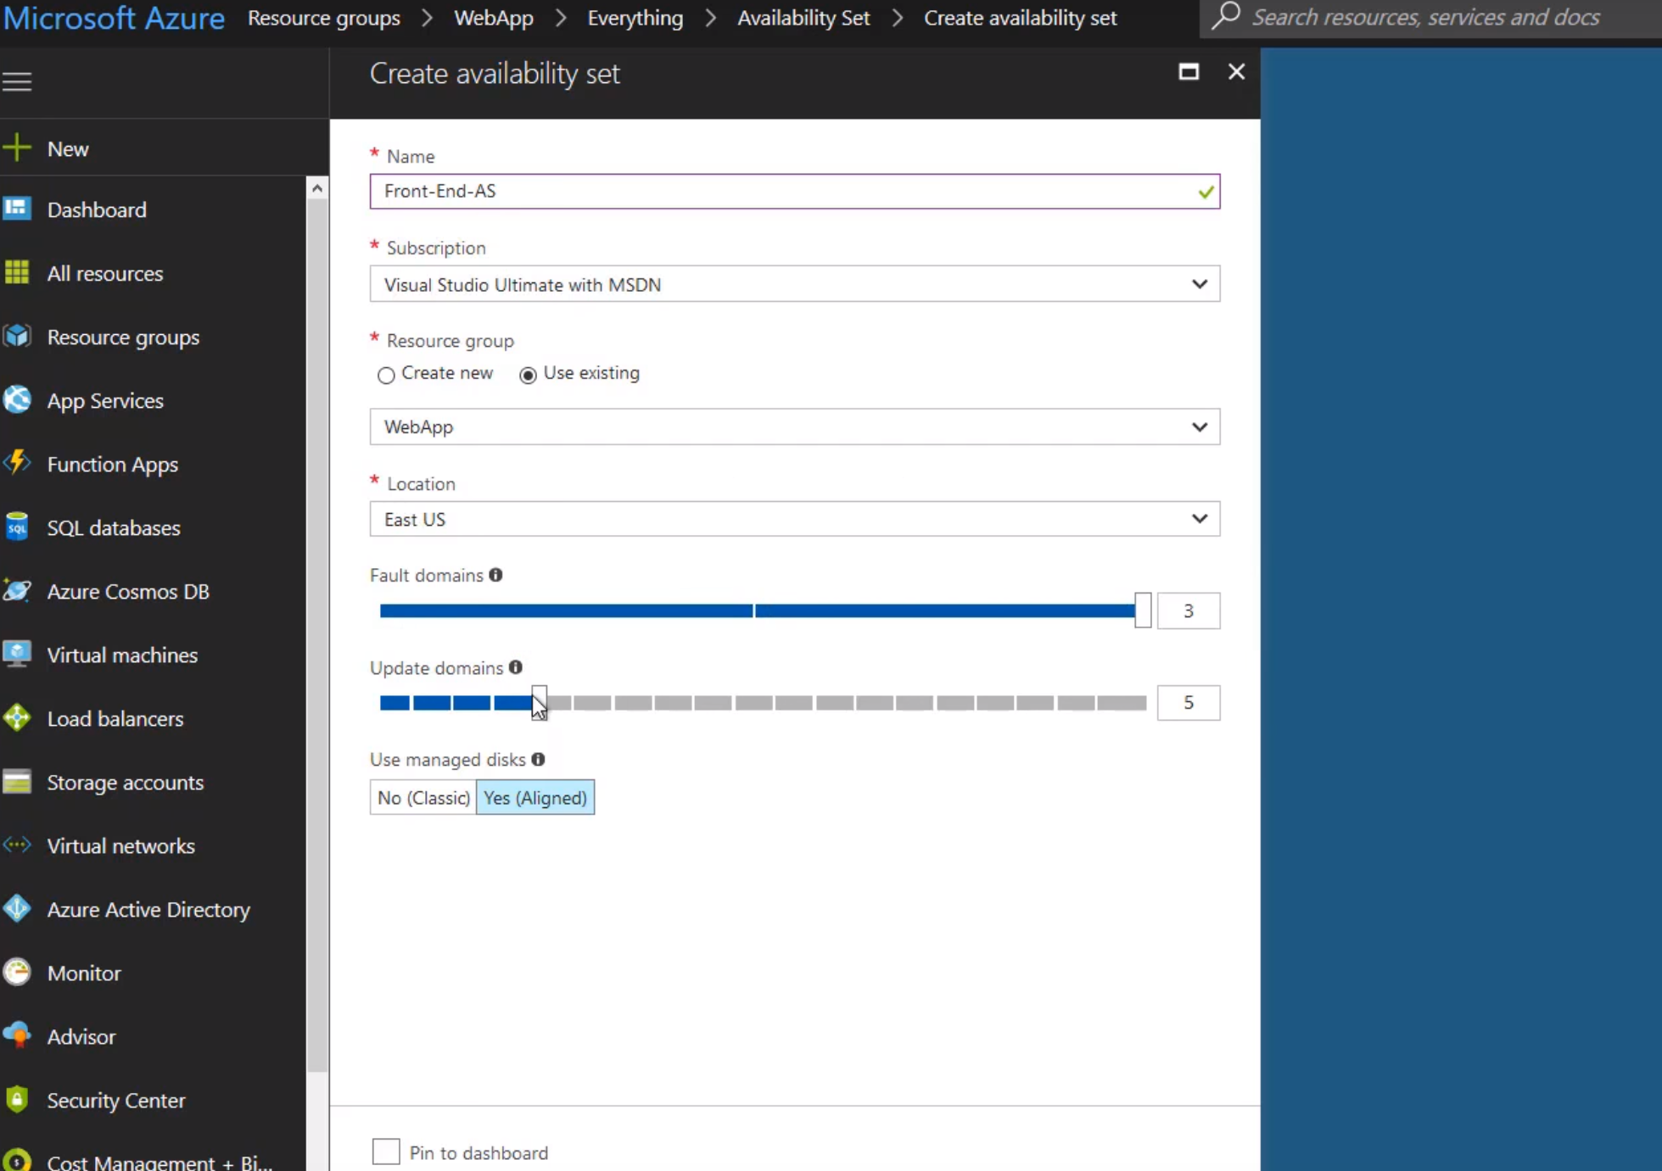
Demonstration: Creating Availability Sets
End to end highly available solution
Redundancy at every level
Always specify an availability set when creating more than one virtual machine for the same purpose
Notes:
Create Availability Sets - https://www.youtube.com/embed/Lh4hrWE07nY
The idea of an availability set is that you achieve a better availability of your workload. You get maximum of 3 fault domains for your VMs.
Think of these 3 Fault domains in an availability set as a 3 node cluster.
Virtual machines in the same fault domain share a common power source and physical network switch.
Update domain – virtual machines in the same domain will be restarted together during planned maintenance.
Azure never restarts more than one update domain at a time.

Slide 81
Practice: Deploying a Highly Available VM
Create an Azure availability group
Deploy a Windows Server 2016 virtual machine into the availability set
Configure networking and storage for the virtual machine
You can also try Tutorial: Create and deploy highly available virtual machines with Azure PowerShell

Slide 82
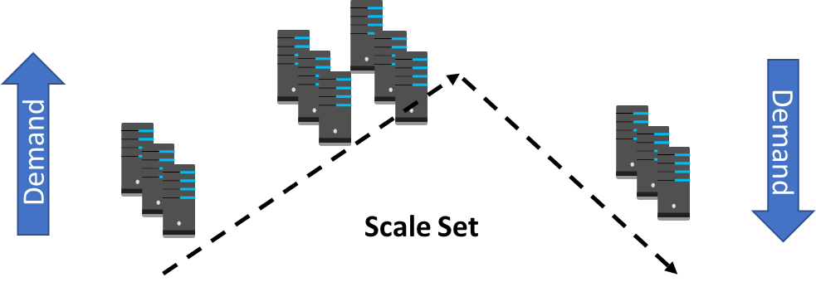
Scale Sets
Scale sets deploy a set of identical VMs
No pre-provisioning of VMs is required
As demand goes up VMs are added, as demand goes down VM are removed
The process can be manual, automated, or a combination of both
Notes:
rubidium DEMO
Why use virtual machine scale sets? - https://docs.microsoft.com/en-us/azure/virtual-machine-scale-sets/overview#why-use-virtual-machine-scale-sets
Differences between virtual machines and scale sets - https://docs.microsoft.com/en-us/azure/virtual-machine-scale-sets/overview#differences-between-virtual-machines-and-scale-sets
Best Practices for Autoscale - https://docs.microsoft.com/en-us/azure/monitoring-and-diagnostics/insights-autoscale-best-practices

Slide 83
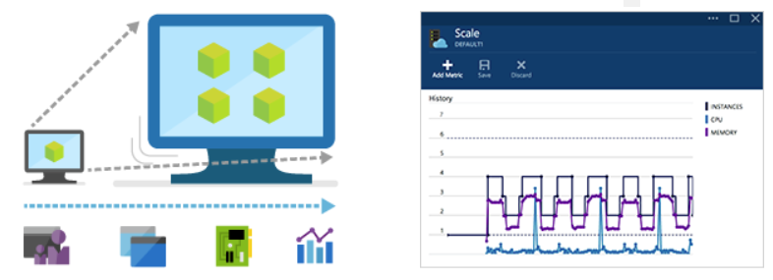
Autoscale
Define rules to automatically adjust capacity
Scale out (increase) the number of VMs in the set
Scale in (reduce) the number of VMs in the set
Schedule events to increase or decrease at a fixed time
Reduces monitoring and optimizes performance
Notes:
Autoscale minimizes the number of unnecessary VM instances that run your application when demand is low
An Azure virtual machine scale set can automatically increase or decrease the number of VM instances that run your application. This automated and elastic behavior reduces the management overhead to monitor and optimize the performance of your application. You create rules that define the acceptable performance for a positive customer experience. When those defined thresholds are met, autoscale rules take action to adjust the capacity of your scale set. You can also schedule events to automatically increase or decrease the capacity of your scale set at fixed times.
Azure Autoscale - https://azure.microsoft.com/en-us/features/autoscale/
Can be scheduled
Metric name Percentage
CPU
Network In
Network Out
Disk Read Bytes
Disk Write Bytes
Disk Read Operations/Sec
Disk Write Operations/Sec
CPU Credits
Remaining CPU
Credits Consumed

Slide 84
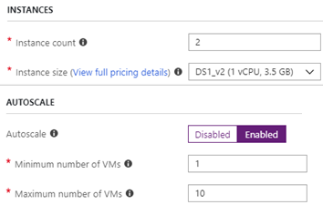

Implementing Autoscale
Define a minimum, maximum, and default number of VM instances
Create simple scale sets with scale out and scale in parameters
Notes:
Take a look in the portal at the basic autoscale parameters.

Slide 85
Demonstration: Creating Scale Sets
Use Scale sets to reliably deploy and update at large scale
Deploy a group of virtual machines with the same configuration
Allow Azure to bring additional machines online or remove them
Based on the load or other criteria you have established
Notes:
Scale Sets - https://www.youtube.com/embed/IhYRZ8ny6b0

Slide 86
Practice: Scale Sets
Create a virtual machine scale set.
Connect to a VM in the scale set.
Notes:
QuickStart: Create a virtual machine scale set in the Azure portal - https://docs.microsoft.com/en-us/azure/virtual-machine-scale-sets/quick-create-portal
QuickStart: Create a virtual machine scale set with the Azure CLI 2.0 – https://docs.microsoft.com/en-us/azure/virtual-machine-scale-sets/quick-create-cli
QuickStart: Create a virtual machine scale set with Azure PowerShell - https://docs.microsoft.com/en-us/azure/virtual-machine-scale-sets/quick-create-powershell

Slide 87
Practice: Autoscale
Create a rule to automatically scale out.
Create a rule to automatically scale in.
Define autoscale instance limits.
Monitor number of instances in a scale set.
Autoscale based on a schedule
Notes:
Automatically scale a virtual machine scale set in the Azure portal - https://docs.microsoft.com/en-us/azure/virtual-machine-scale-sets/virtual-machine-scale-sets-autoscale-portal
Tutorial: Automatically scale a virtual machine scale set with Azure PowerShell - https://docs.microsoft.com/en-us/azure/virtual-machine-scale-sets/tutorial-autoscale-powershell
Tutorial: Automatically scale a virtual machine scale set with the Azure CLI 2.0 - https://docs.microsoft.com/en-us/azure/virtual-machine-scale-sets/tutorial-autoscale-cli

Slide 88
Objective Review - #4
Automate deployment of Virtual Machines (VMs)
Modify Azure Resource Manager (ARM) template
Configure location of new VMs
Configure VHD template
Deploy from template
Save a deployment as an ARM template
Deploy Windows and Linux VMs

Slide 89
Resource Manager Templates
Element name | Required | Description
$schema | Yes | Location of the JSON schema file that describes the version of the template language. Use the URL shown in the preceding example.
contentVersion | Yes | Version of the template (such as 1.0.0.0). You can provide any value for this element. Use this value to document significant changes in your template. When deploying resources using the template, this value can be used to make sure that the right template is being used.
parameters | No | Values that are provided when deployment is executed to customize resource deployment.
variables | No | Values that are used as JSON fragments in the template to simplify template language expressions.
functions | No | User-defined functions that are available within the template.
resources | Yes | Resource types that are deployed or updated in a resource group.
outputs | No | Values that are returned after deployment.
Notes:
Review the reference link for the details on how parameters, variables, outputs, and resources are defined.
Understand the structure and syntax of Azure Resource Manager Templates - https://docs.microsoft.com/en-us/azure/azure-resource-manager/resource-group-authoring-templates#template-limits

Slide 90

ARM Process
Azure provides many QuickStart templates. As much as possible, you should make use of these templates.
Values for the ARM template are provided in a JSON parameters file. You can standardize and reuse the templates.
Use the Portal, PowerShell, or the CLI to deploy the template.
Notes:
Azure Resource Manager templates. Azure Resource Manager (ARM) templates are used to deploy resources into resource groups programatically.
Don't forget to properly secure any username and password parameters that are included in the JSON files.
Azure QuickStart templates - https://azure.microsoft.com/en-us/resources/templates/

Slide 91
Demonstration: Create a VM using ARM
Create a template file (JSON) to deploy required resources
Deployment options
Quickstart template on GitHub – allows you to take any JSON file, correctly structured and syntactically correct and feed it into the portal
Azure Marketplace – in reality, a wizard for JSON-based deployments
Deploy ARM templates directly from Visual Studio code
Supply a parameters file that contains the parameter values to the template
Notes:
Create a VM using ARM - https://www.youtube.com/embed/MkPruUHiv5o

Slide 92
Practice: Creating Virtual Machines (Template)
Create template
Deploy template
Notes:
Create and deploy your first Azure Resource Manager template - https://docs.microsoft.com/en-us/azure/azure-resource-manager/resource-manager-create-first-template
Troubleshoot common Azure deployment errors with Azure Resource Manager - https://docs.microsoft.com/en-us/azure/azure-resource-manager/resource-manager-common-deployment-errors

Slide 93
Save a deployment as an ARM template
Export template – duplicate of original template
Deployed in portal
Readily usable
Template representing current state
snapshot/backup of Resource Group
Hard coded values
If use for another resource group, may have to significantly modify

Slide 94
Objective Review - #5
Create connectivity between virtual networks
Create and configure VNET peering
Create and configure VNET to VNET
Verify virtual network connectivity
Create virtual network gateway

Slide 95

VNet Peering
VNet peering connects two Azure virtual networks (not transient)
Two types of peering: Regional and Global
Peered networks use the Azure backbone for privacy and isolation
Easy to setup, seamless data transfer, and great performance
Notes:
VNET peering – seamlessly connect two Azure virtual networks so they appear as one
Traffic is routed through background network using private IP’s so traffic is private
Low-latency, high-bandwidth
Transfer data across subscriptions, regions, deployments
No downtime
Global VNET peering – connect across regions
The default VNet peering configuration provides full connectivity.
Virtual network peering - https://docs.microsoft.com/en-us/azure/virtual-network/virtual-network-peering-overview

Slide 96

Regional VNet Peering
Allow forwarded traffic from within the peer virtual network into your virtual network.
Allow gateway transit. Allows the peer virtual network to use your virtual network gateway. (upcoming topic)
Use remote gateways. Only one virtual network can have this enabled
Notes:
Remember If virtual network address spaces overlap, the virtual networks cannot be peered.
Create a peering - https://docs.microsoft.com/en-us/azure/virtual-network/virtual-network-manage-peering#create-a-peering

Slide 97

Global VNet Peering
Global VNet peering connects virtual networks across regions
Status will be Initiated or Connected
Special requirements: public clouds only, virtual network resource limitations, no gateway transit, no transitivity, and limitations on high performance virtual machines.
Notes:
Global VNet Peering enables resources in your virtual network to communicate across Azure regions privately through the Microsoft backbone. VMs across virtual networks can communicate directly without gateways, extra hops, or transit over the public internet. This allows a high-bandwidth, low-latency connection across peered virtual networks in different regions.
How to setup Global VNet peering in Azure - https://blogs.msdn.microsoft.com/azureedu/2018/04/24/how-to-setup-global-vnet-peering-in-azure/
Requirements and constraints - https://docs.microsoft.com/en-us/azure/virtual-network/virtual-network-manage-peering#requirements-and-constraints

Slide 98

Gateway Transit
Gateway transit allows peered virtual networks to share the gateway and get access to resources.
This means you do not need to deploy a VPN gateway in the peer virtual network.
Notes:
When working with gateway subnets, avoid associating a network security group (NSG) to the gateway subnet. Associating a network security group to this subnet may cause your VPN gateway to stop functioning as expected.
Gateway transit is a peering property that enables one virtual network to utilize the VPN gateway in the peered virtual network for cross-premises or VNet-to-VNet connectivity.
Gateway transit - https://docs.microsoft.com/en-us/azure/vpn-gateway/vpn-gateway-peering-gateway-transit?toc=%2fazure%2fvirtual-network%2ftoc.json
PowerShell Example - https://docs.microsoft.com/en-us/azure/vpn-gateway/vpn-gateway-peering-gateway-transit?toc=%2fazure%2fvirtual-network%2ftoc.json#powershell-sample
Hub and spoke - https://docs.microsoft.com/en-us/azure/architecture/reference-architectures/hybrid-networking/hub-spoke
Gateway Subnet - https://docs.microsoft.com/en-us/azure/vpn-gateway/vpn-gateway-about-vpn-gateway-settings#gwsub

Slide 99
VNET Review Questions
You configure a VNet-to-VNet connection between two VNets hosted in Azure across two regions. The VNets contain virtual machines (VMs) used for a business-critical application. How can you verify that the VNet peering has been successfully established? What are the benefits and constraints for global VNet peering?
You configure VNet peering between two virtual networks. You create a virtual machine (VM) in each network to test communication. What configuration options should you consider?
Notes:
Q2 Answer:
You can check the status of VNet peering. The peering is not successfully established until the peering status for both virtual network peerings shows Connected. Initiated means you have created the peering, but are not yet connected.
The benefits and configuration steps are the same as for regional peering, but there are some special requirements: public clouds only, virtual network resource limitations, no gateway transit, no transitivity, and limitations on high performance virtual machines.
Q3 Answer:
You must configure the peering on each virtual network. If you select ‘allow gateway transit’ on one virtual network; then you should select ‘use remote gateways’ on the other virtual network.
The options available to configure: allow forwarded traffic, allow gateway transit, and use remote gateways.

Slide 100
Objective Review - #6
Implement and manage virtual networking
Configure private and public IP addresses, network routes, network interface, subnets, and virtual network

Slide 101

Video: IP Addressing
Notes:
IP Addressing - https://www.youtube.com/embed/FWIgU0yhM4o

Slide 102

Private and Public IP Addresses
Private IP addresses are used for communication within an Azure virtual network (VNet), and your on-premises network, when you use a VPN gateway or ExpressRoute circuit to extend your network to Azure.
Public IP addresses is used for communication with the Internet, including Azure public-facing services.
Notes:
As a best practice you may decide to separate dynamically and statically assigned IP resources into different subnets. And, IP Addresses are never managed from within a virtual machine.
A VPN gateway is a specific type of virtual network gateway that is used to send encrypted traffic between an Azure virtual network and an on-premises location over the public Internet. You can also use a VPN gateway to send encrypted traffic between Azure virtual networks over the Microsoft network. Each virtual network can have only one VPN gateway. However, you can create multiple connections to the same VPN gateway. When you create multiple connections to the same VPN gateway, all VPN tunnels share the available gateway bandwidth.

Slide 103

System Routes
System routes direct network traffic between virtual machines, on-premises networks, and the Internet
Traffic between VMs in the same subnet
Between VMs in different subnets in the same virtual network
Data flow from VMs to the Internet
Communication between VMs using a VNet-to-VNet VPN
Site-to-Site and ExpressRoute communication through the VPN gateway
Notes:
Azure automatically creates system routes and assigns the routes to each subnet in a virtual network. You can't create system routes, nor can you remove system routes, but you can override some system routes with custom routes. Azure also adds additional optional default routes to specific subnets, or every subnet, when you use specific Azure capabilities.
System routes - https://docs.microsoft.com/en-us/azure/virtual-network/virtual-networks-udr-overview#system-routes

Slide 104

User Defined Routes
A route table contains a set of rules, called routes, that specifies how packets should be routed in a virtual network
User-defined routes are custom routes that control network traffic by defining routes that specify the next hop of the traffic flow
The next hop can be a virtual network gateway, virtual network, internet, or virtual appliance
Notes:
You create custom routes by either creating user-defined routes, or by exchanging border gateway protocol (BGP) routes between your on-premises network gateway and an Azure virtual network gateway.
Each route table can be associated to multiple subnets, but a subnet can only be associated to a single route table. There are no additional charges for creating route tables in Microsoft Azure.
Custom routes - https://docs.microsoft.com/en-us/azure/virtual-network/virtual-networks-udr-overview#custom-routes

Slide 105

Routing Example
Create the route table
Create the route
Associate the route to the subnet
Notes:
There is practice exercise that includes a complete set of steps for this scenario, including creating the virtual appliance and testing. The next three slides implement this specific example.

Slide 106

Introduction to Azure Networking Components
Adopting cloud solutions can save time and simplify operations
Azure requires the same types of networking functionality as on-premises infrastructure
Azure networking offers a wide range of services and products
Notes:
Take a minute to review each component.
Azure Virtual Networks - https://azure.microsoft.com/en-us/services/virtual-network/

Slide 107

Virtual Networks
Logical representation of your own network
Create a dedicated private cloud-only VNet
Securely extend your datacenter With VNets
Enable hybrid cloud scenarios
Notes:
An Azure virtual network (VNet) is a representation of your own network in the cloud. It is a logical isolation of the Azure cloud dedicated to your subscription.
What is an Azure virtual network? - https://docs.microsoft.com/en-us/azure/virtual-network/virtual-networks-faq#what-is-an-azure-virtual-network-vnet
Border Gateway Protoco - BGP is the standard routing protocol commonly used in the Internet to exchange routing and reachability information between two or more networks. When used in the context of Azure Virtual Networks, BGP enables the Azure VPN Gateways and your on-premises VPN devices, called BGP peers or neighbors, to exchange "routes" that will inform both gateways on the availability and reachability for those prefixes to go through the gateways or routers involved. BGP can also enable transit routing among multiple networks by propagating routes a BGP gateway learns from one BGP peer to all other BGP peers.
Why use BGP?
Support automatic and flexible prefix updates
Support multiple tunnels between a VNet and an on-premises site with automatic failover based on BGP
Support transit routing between your on-premises networks and multiple Azure VNets
An on-premises network gateway can exchange routes with an Azure virtual network gateway using the border gateway protocol (BGP). Using BGP with an Azure virtual network gateway is dependent on the type you selected when you created the gateway. If the type you selected were:
ExpressRoute: You must use BGP to advertise on-premises routes to the Microsoft edge router. You cannot create user-defined routes to force traffic to the ExpressRoute virtual network gateway if you deploy a virtual network gateway deployed as type: ExpressRoute. You can use user-defined routes for forcing traffic from the Express Route to, for example, a Network Virtual Appliance.
VPN: You can, optionally use BGP. For details, see BGP with site-to-site VPN connections
g

Slide 108

Subnets
A virtual network can be segmented into one or more subnets
Subnets provide logical divisions within your network
Subnets can help improve security, increase performance, and make it easier to manage the network
Notes:
All Azure resources deployed into a virtual network are deployed into a subnet within a virtual network.
Generally, discuss service requirements and virtual appliances.
✔️ Azure reserves the first three IP addresses and the last IP address in each subnet address range.
Subnets - https://docs.microsoft.com/en-us/azure/virtual-network/virtual-network-VNet-plan-design-arm#subnets
Services that can be deployed into a virtual network - https://docs.microsoft.com/en-us/azure/virtual-network/virtual-network-for-azure-services#services-that-can-be-deployed-into-a-virtual-network

Slide 109
Video: Managing Virtual Networks (Common Tasks)
Creating a virtual network
Viewing virtual networks and settings
Adding and removing address spaces
Adding and changing a DNS server
Deleting a virtual network
Notes:
Managing Virtual Networks (Common Tasks) - https://www.youtube.com/embed/zIX6ofSpc2U

Slide 110
Practice: Virtual Networks
Create a virtual network
Create virtual machines
Connect to a VM from the internet
Communicate between VMs
Notes:
Virtual Networks Practice - https://docs.microsoft.com/en-us/azure/virtual-network/quick-create-portal

Slide 111
Objective Review - #7
Manage Azure Active Directory (AD)
Add custom domains
Configure Azure AD Identity Protection, Azure AD Join, and Enterprise State Roaming
Configure self-service password reset
Implement conditional access policies
Manage multiple directories
Perform an access review

Slide 112
AD Custom Domain
Create your domain name with a domain registrar
Create your directory in Azure AD
Add your custom domain name to Azure AD
Add your DNS information to the domain registrar
Verify your custom domain name
Notes:
Every new Azure AD tenant comes with an initial domain name, domainname.onmicrosoft.com. You can't change or delete the initial domain name, but you can add your organization's names to the list. Adding custom domain names helps you to create user names that are familiar to your users, such as alain@contoso.com.
https://docs.microsoft.com/en-us/azure/active-directory/fundamentals/add-custom-domain
Tutorial
https://docs.microsoft.com/en-us/Azure/app-service/app-service-web-tutorial-custom-domain

Slide 113


Azure Active Directory Identity Protection
Connected Intelligence
Delivering intelligent security requires a cloud-powered solution
Proactive, AI-enhanced protection
Automatic, real-time remediation
Machine learning at a massive scale
Detect potential vulnerabilities
Configure automated responses
Ability to:
Consolidated view of flagged users and risk events
Set risk-based Conditional Access policies to automatically protect your users
Improve security posture
Proactive Protection
Continuous Detection
Your organization
Logs
Relying parties
Self-reporting
Threat data
Behavior
Actionable insights and validation
Notes:
Azure Active Directory uses adaptive machine learning algorithms and heuristics to detect anomalies and suspicious incidents that indicate potentially compromised identities. Using this data, Identity Protection generates reports and alerts that enable you to evaluate the detected issues and take appropriate mitigation or remediation actions.

Slide 114
Azure AD Join
Ability for users to have a self-service experience to join their devices to the company network
No need to join on-premises AD
Enterprise and at-scale ready
Notes:
Azure AD Join is that it provides users with a self-service experience for joining their devices to the company network. By contrast, joining a computer to an on-premises Active Directory domain is done either by an administrator or is built into the imaging process when creating corporate images for installing Windows.
Azure AD enables you to manage the identity of devices used by your organization and control access to corporate resources from these devices. Users can register their personal (bring-your-own) device with Azure AD, which provides the device with an identity. Subsequently, Azure AD can authenticate the device when a user signs in to Azure AD and uses the device to access secured resources. Further, you can manage the device using Mobile Device Management (MDM) software like Microsoft Intune. This feature enables you to restrict access to sensitive resources from managed and policy-compliant devices.
You can also join organization owned devices to Azure AD. This mechanism offers the same benefits of registering a personal device with Azure AD. Additionally, users can sign in to the device using their corporate credentials.
fAzure AD joined devices give you the following benefits:
Single-sign-on (SSO) to applications secured by Azure AD
Enterprise policy-compliant roaming of user settings across devices.
Access to the Windows Store for Business using your corporate credentials.
Windows Hello for Business
Restricted access to apps and resources from devices compliant with corporate policy.

Slide 115
Enterprise State Roaming
Enterprise State Roaming provides users with a unified experience across their Windows devices and reduces the time needed for configuring a new device/synchronizing user and app settings data to the cloud.
Similar to consumer settings sync that was first introduced in Windows as well as:
Separation of corporate and consumer data
Enhanced security
Better management and monitoring
Notes:
Separation of corporate and consumer data – Organizations are in control of their data, and there is no mixing of corporate data in a consumer cloud account or consumer data in an enterprise cloud account.
Enhanced security – Data is automatically encrypted before leaving the user’s Windows 10 device by using Azure Rights Management (Azure RMS), and data stays encrypted at rest in the cloud. All content stays encrypted at rest in the cloud, except for the namespaces, like settings names and Windows app names.
Better management and monitoring – Provides control and visibility over who syncs settings in your organization and on which devices through the Azure AD portal integration.

Slide 116
Objective Review - #8
Implement and manage hybrid identities
Install and configure Azure AD Connect
Configure federation and single sign-on
Manage Azure AD Connect
Manage password sync and writeback

Slide 117

Azure AD Connect
Integrates AD DS with Azure AD:
Implements a common identity for your users across Azure, Office 365, and SaaS apps
Provides support for:
Sync Services: synchronize AD DS objects, such as users and groups.
Health Monitoring: offers centralized monitoring
Federation: simplifies configuration of AD FS
Filtering of synchronization scope
Password hash synchronization
Protection against accidental deletes
Password writeback
Device writeback
Automatic upgrades

Slide 118
Active Directory Connect
Staging Mode
High availability
Test and deploy new configuration changes
Introduce a new server and decommission the old
Notes:
With a server in staging mode, you can make changes to the configuration and preview the changes before you make the server active. It also allows you to run full import and full synchronization to verify that all changes are expected before you make these changes into your production environment.
Suppose you have an Azure AD Connect with Password Hash Synchronization feature enabled. When you enable staging mode, the server stops synchronizing password changes from on-premises AD. When you disable staging mode, the server resumes synchronizing password changes from where it last left off. If the server is left in staging mode for an extended period of time, it can take a while for the server to synchronize all password changes that had occurred during the time period.
https://docs.microsoft.com/en-us/azure/active-directory/hybrid/how-to-connect-sync-operations

Slide 119

Active Directory Connect Writeback
Subscription to Azure AD Premium is required for device writeback
Used to enable conditional access based on devices to ADFS (2012 R2 or higher) protected applications (relying party trusts)
Notes:
https://docs.microsoft.com/en-us/azure/active-directory/hybrid/how-to-connect-device-writeback

Slide 120

Password hash synchronization with AD
Notes:
Password hash synchronization is one of the sign-in methods used to accomplish hybrid identity. Azure AD Connect synchronizes a hash, of the hash, of a users password from an on-premises Active Directory instance to a cloud-based Azure AD instance.
Password hash synchronization is an extension to the directory synchronization feature implemented by Azure AD Connect sync. You can use this feature to sign in to Azure AD services like Office 365. You sign in to the service by using the same password you use to sign in to your on-premises Active Directory instance.
Password hash synchronization helps by reducing the number of passwords, your users need to maintain to just one. Password hash synchronization can:
Improve the productivity of your users.
Reduce your helpdesk costs.
Optionally, you can set up password hash synchronization as a backup if you decide to use Federation with Active Directory Federation Services (AD FS) as your sign-in method.
To use password hash synchronization in your environment, you need to:
Install Azure AD Connect.
Configure directory synchronization between your on-premises Active Directory instance and your Azure Active Directory instance.
Enable password hash synchronization.

Slide 121

Azure AD Pass-Through Synchronization (alternative to Password Sync)
Notes:
This feature is an alternative to Azure AD Password Hash Synchronization, which provides the same benefit of cloud authentication to organizations. However, certain organizations wanting to enforce their on-premises Active Directory security and password policies, can choose to use Pass-through Authentication instead.
Benefits:
Great user experience
Users use the same passwords to sign into both on-premises and cloud-based applications.
Users spend less time talking to the IT helpdesk resolving password-related issues.
Users can complete self-service password management tasks in the cloud.
Easy to deploy & administer
No need for complex on-premises deployments or network configuration.
Needs just a lightweight agent to be installed on-premises.
No management overhead. The agent automatically receives improvements and bug fixes.
Secure
On-premises passwords are never stored in the cloud in any form.
Protects your user accounts by working seamlessly with Azure AD Conditional Access policies, including Multi-Factor Authentication (MFA), blocking legacy authentication and by filtering out brute force password attacks.
The agent only makes outbound connections from within your network. Therefore, there is no requirement to install the agent in a perimeter network, also known as a DMZ.
The communication between an agent and Azure AD is secured using certificate-based authentication. These certificates are automatically renewed every few months by Azure AD.
Highly available
Additional agents can be installed on multiple on-premises servers to provide high availability of sign-in requests.

Slide 122

Federation
Notes:
You can federate your on-premises environment with Azure AD and use this federation for authentication and authorization. This sign-in method ensures that all user authentication occurs on-premises. This method allows administrators to implement more rigorous levels of access control. Federation with AD FS and PingFederate is available.
Azure Active Directory (Azure AD) Connect lets you configure federation with on-premises Active Directory Federation Services (AD FS) and Azure AD. With federation sign-in, you can enable users to sign in to Azure AD-based services with their on-premises passwords--and, while on the corporate network, without having to enter their passwords again. By using the federation option with AD FS, you can deploy a new installation of AD FS, or you can specify an existing installation in a Windows Server 2012 R2 farm.

Slide 123
Hybrid Identity
Password hash synchronization (PHS)
Pass-through authentication (PTA)
Federation
Provides single-sign on

Slide 124


Questions?

